Slide 1
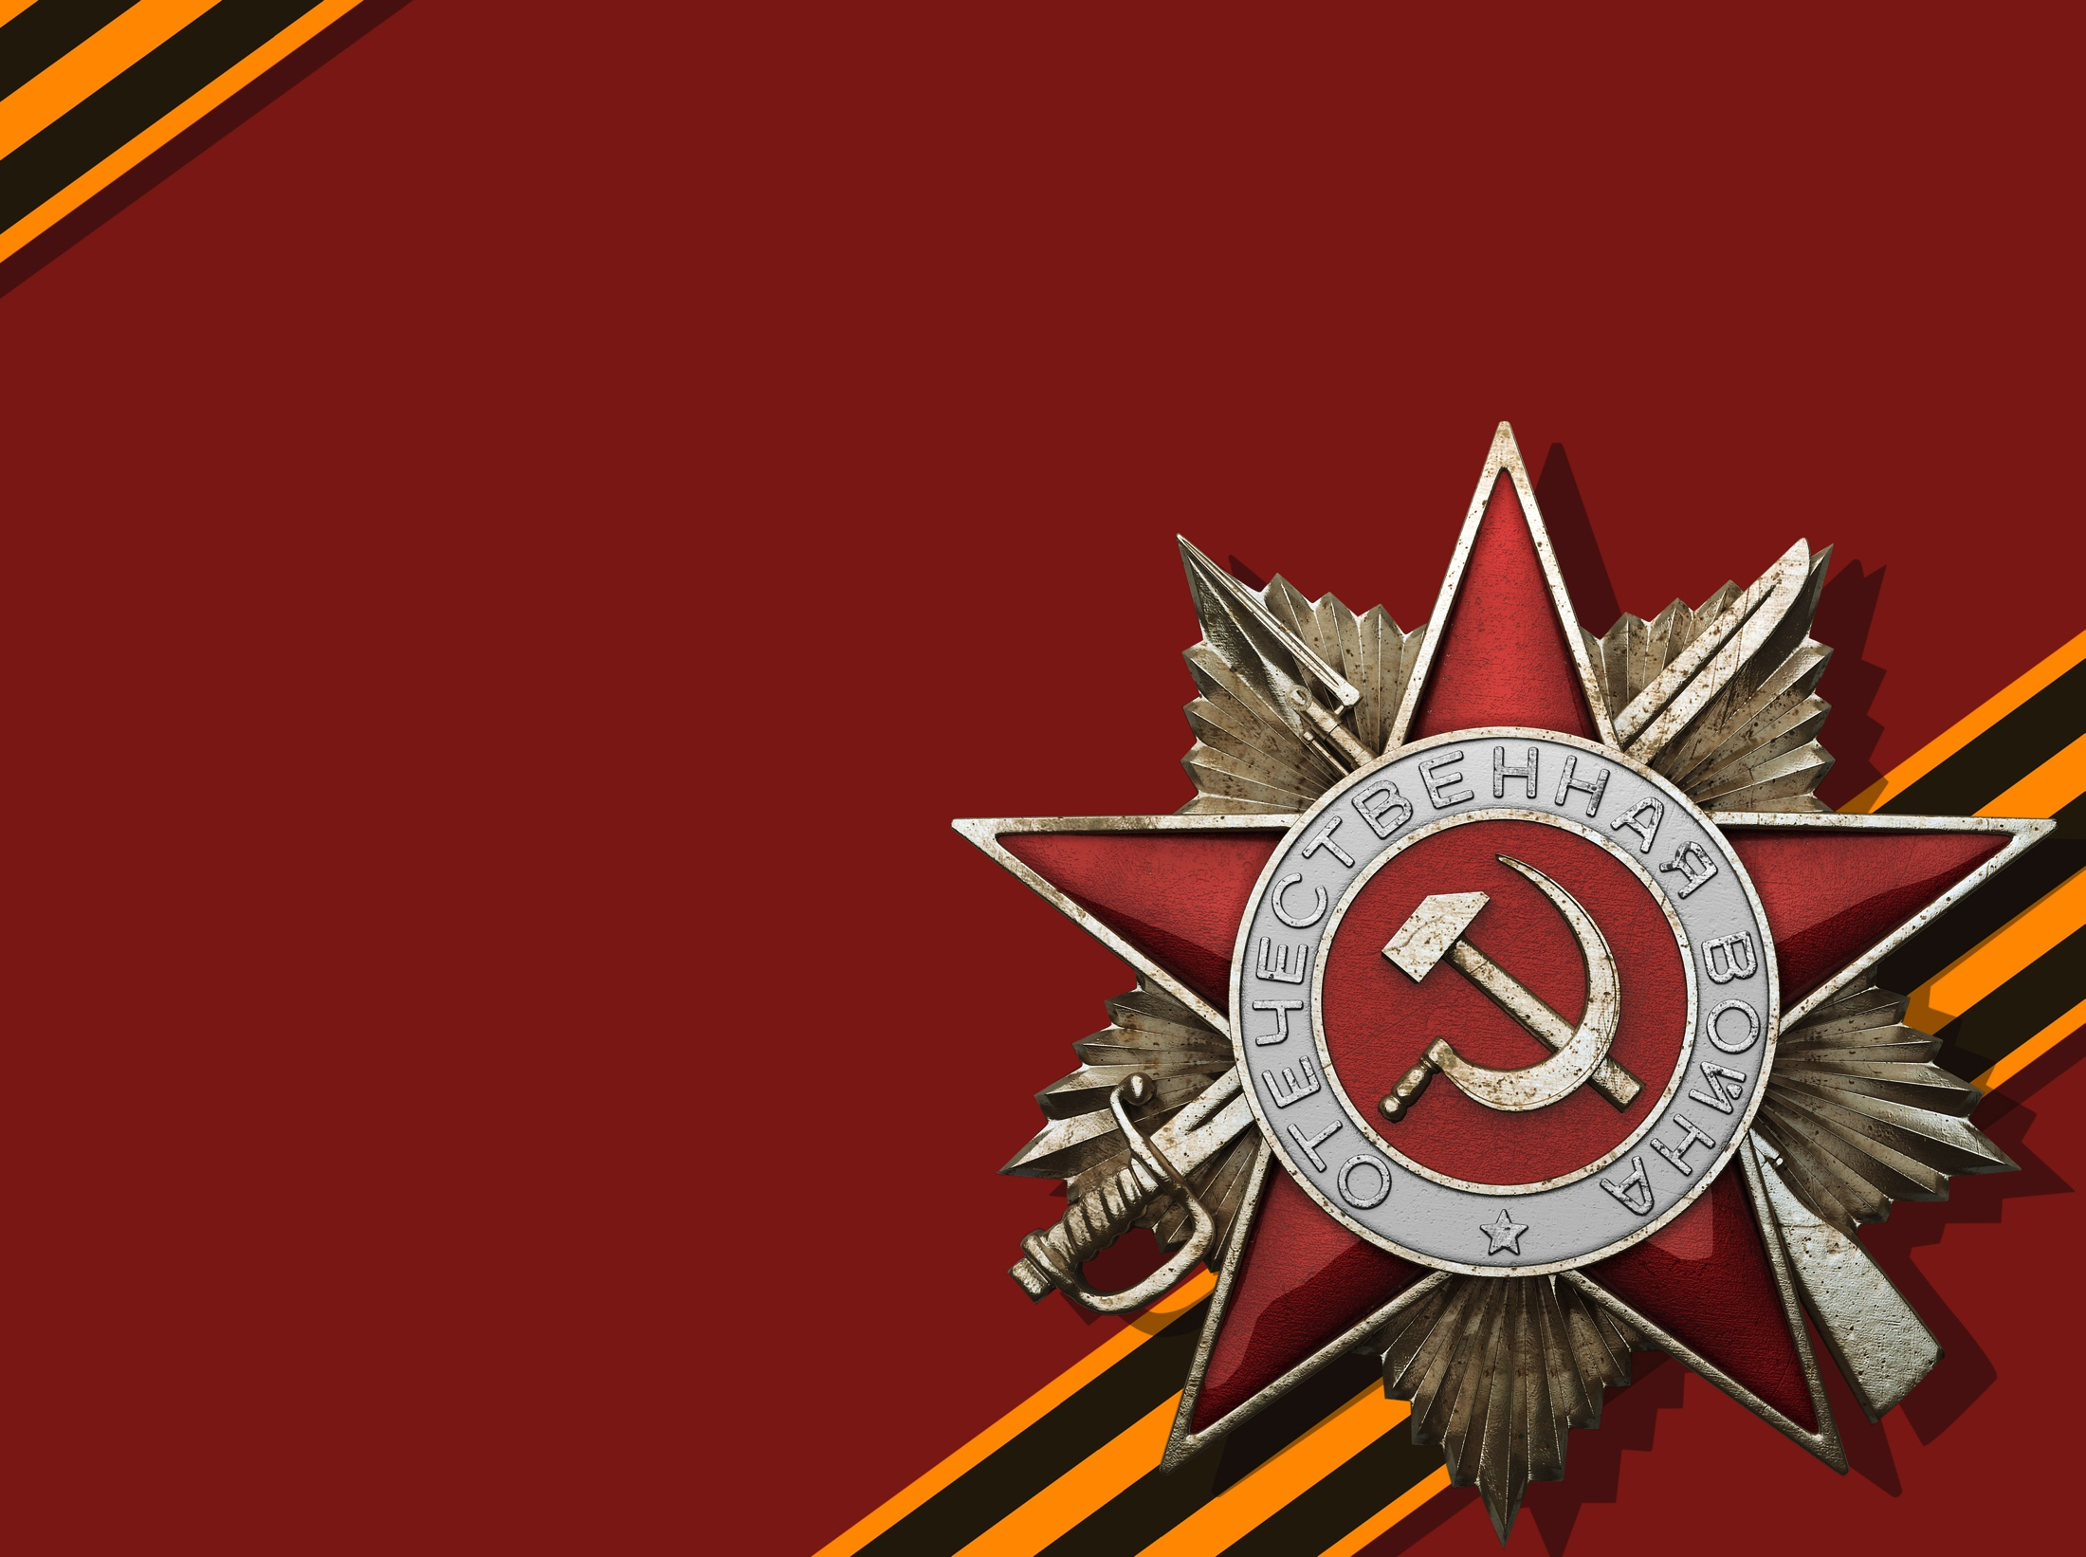
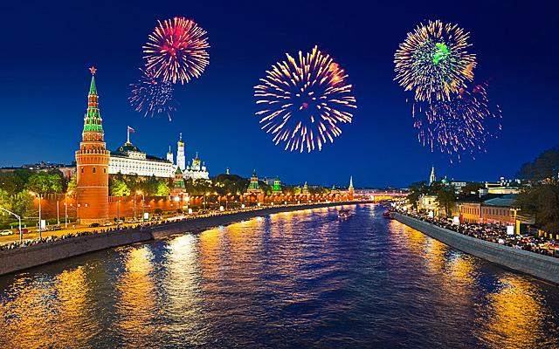
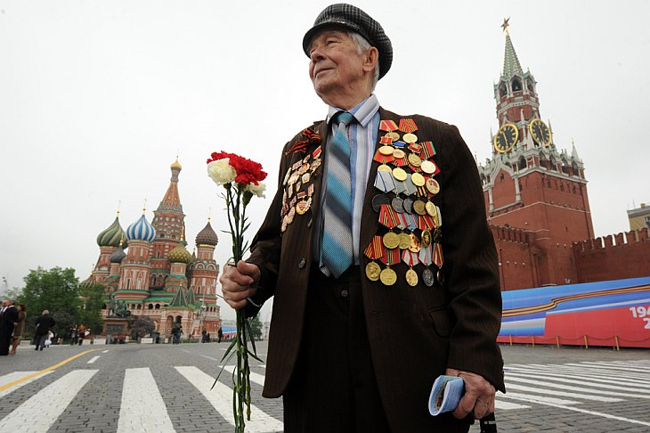
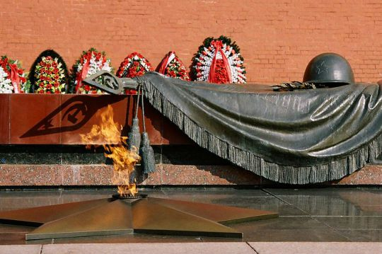
Great Victory Day which is celebrated on 9th of May is one of the most important holidays in our country, it is the happy and sad holiday at the same time. We are happy that our people won such a ruthless Great Patriotic War (1941-1945) and made our country free from fascist invaders. We are sad and grieve about those heroes who lost their lives at those difficult time of battles and hardship.

Slide 2
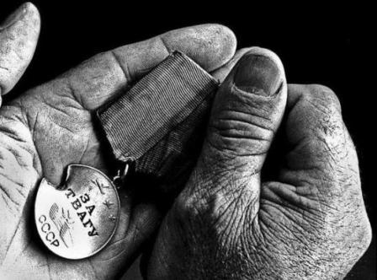
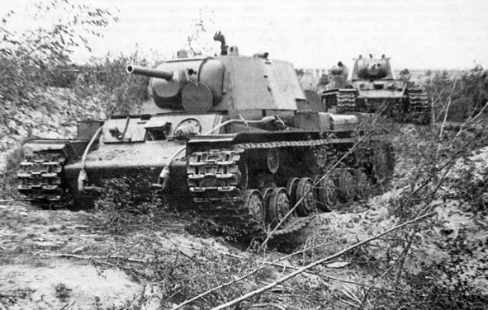
Every city, every man of our big country contributed all they could and did their best to lead our county to the victory and freedom. My native city Ardatov, Mordovia Republic, was not the exception. Many natives went to the battlefield and took part in the war, more than 400 people were awarded with medals. Ardatov people who remained in the rear collected 100 thousand rubles for creation of Mordovia tank column.

Slide 3
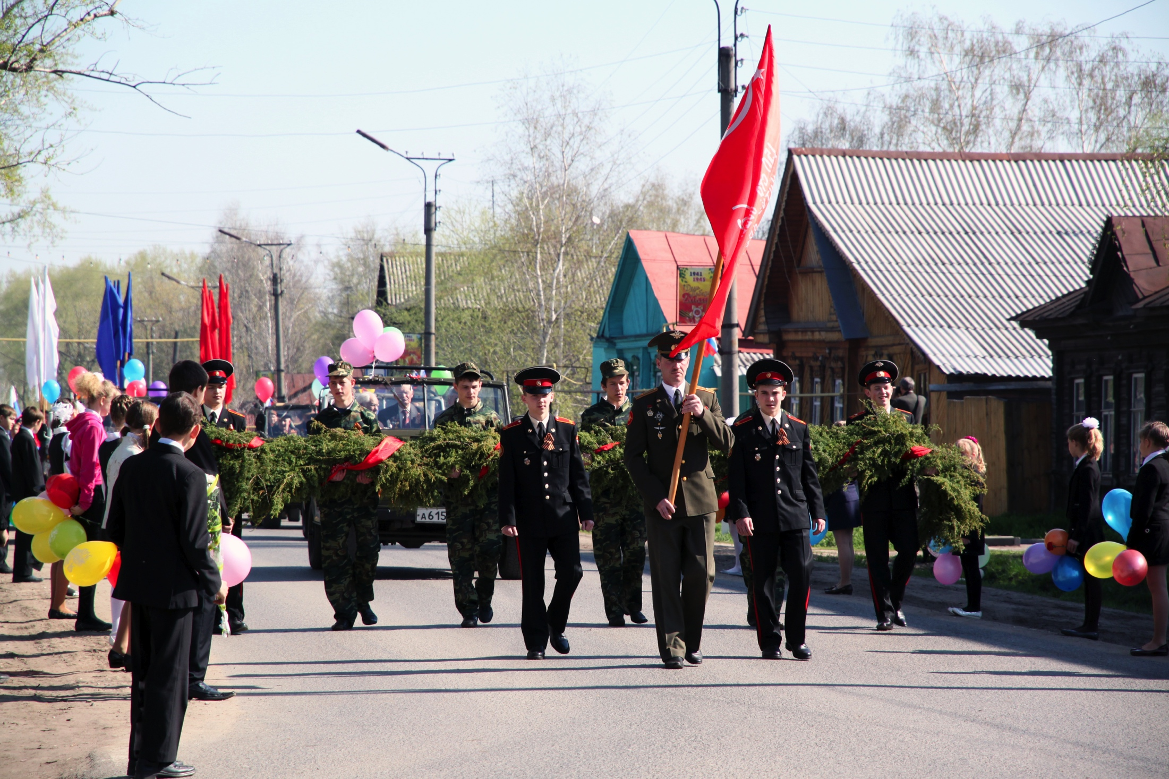
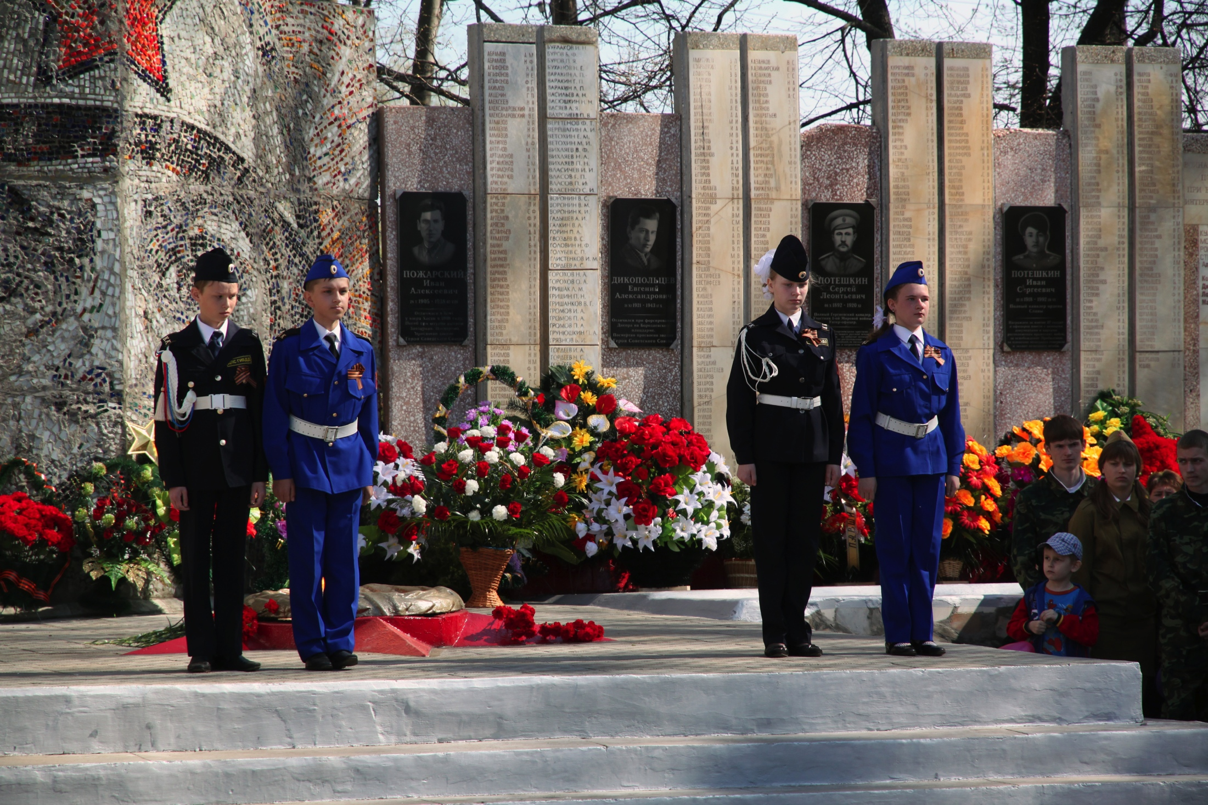
In honour of the victory in Ardatov as in every Russian city parades, concerts and different activities are held. On this day we meet and thank veterans of war and remember and pay tribute to the dead heroes.

Slide 4
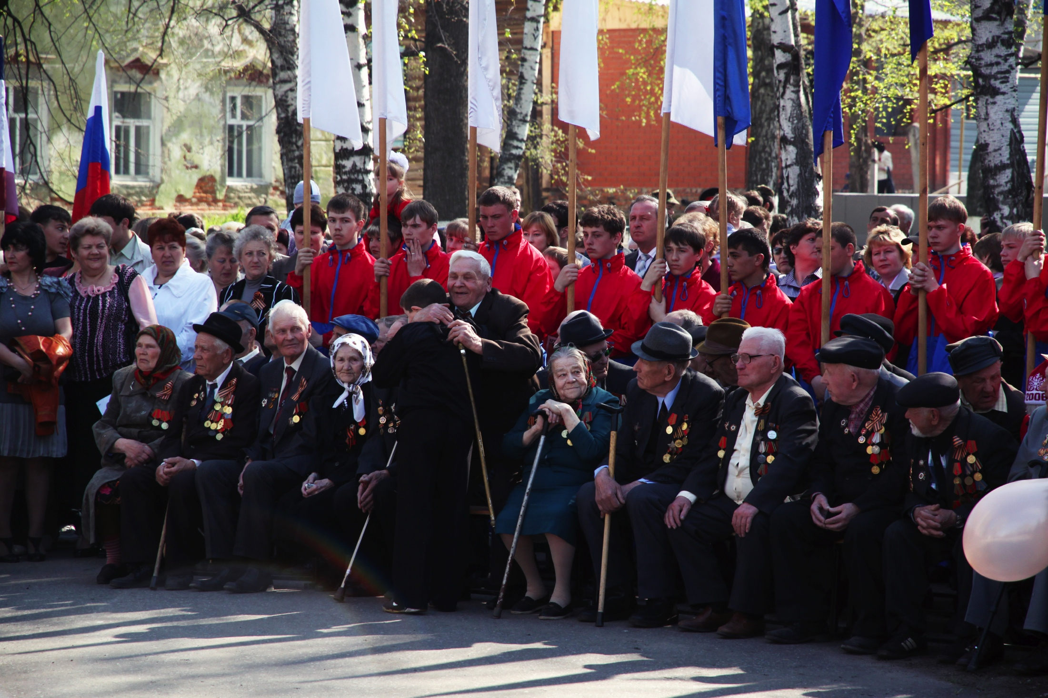
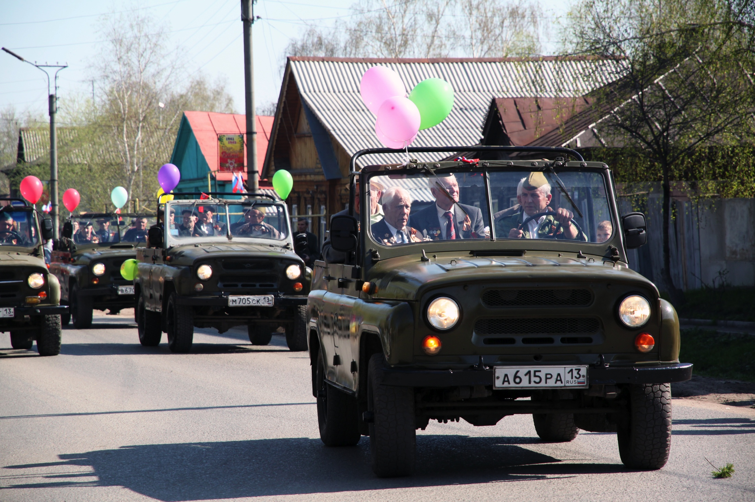
Like many others I can’t hold back the tears looking at these remarkable people who did all they could to give us freedom and peace, whose courage and self-sacrifice are to be admired.

Slide 5
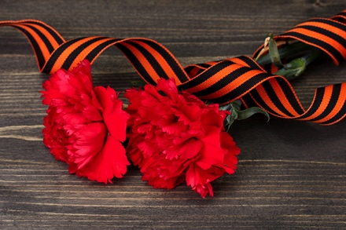
We should know our history and never forget the feats of our people and be proud and grateful to all who risked their lives, who died protecting our Motherland.
I am very proud of our Great Fearless People!

