Slide 2
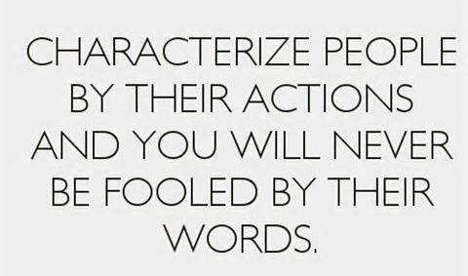

Slide 3
Phrasal verb BRING
Bring - |brɪŋ|
irregular verb:
p.t. — brought p.p. — brought

Slide 4
bring back
to make somebody remember something or think about it again (cause (причина) to recall)
The photographs brought back many pleasant memories.

Slide 5
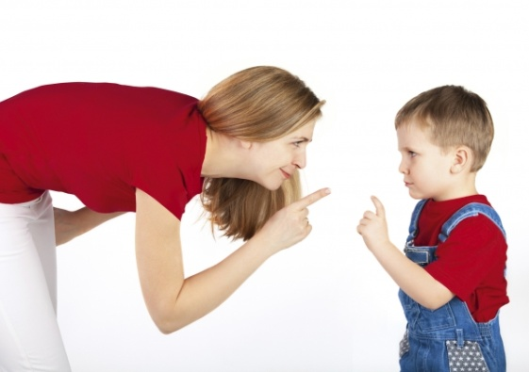
bring up
to care for a child, teaching him or her how to behave, etc. (raise)
She brought up five children

Slide 6
bring about
to make something happen
(cause (причина) to happen)
What you think about and talk about, you bring about!

Slide 7
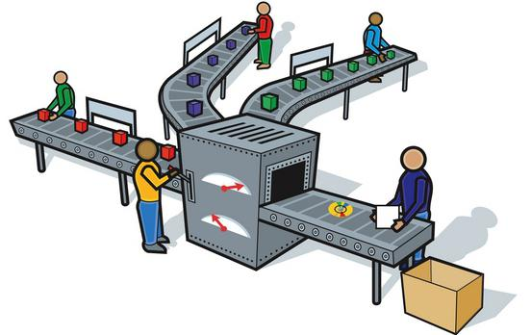
bring out
to produce something; to publish something (put on a market)
They started to bring out magazines for women

Slide 8
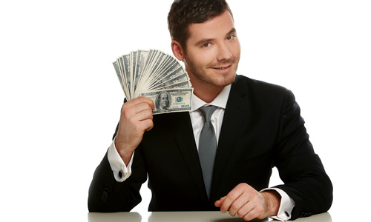
bring in
to make or earn money
How much does he bring in now?

Slide 9
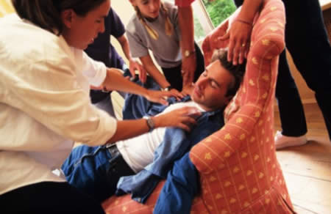
bring round
to make somebody who is unconscious (находящийся без сознания) become conscious again
We bring him round by using some cold water

Slide 10
to make somebody remember something or think about it again (cause (причирна) to recall)
to care for a child, teaching him or her how to behave, etc. (raise)
BACK
UP
BRING
to make somebody who is unconscious (находящийся без сознания) become conscious again
to make something happen
(cause (причина)to happen)
ROUND
ABOUT
to produce something; to publish something (put on a market)
to make or earn (зарабатывать)
IN
OUT

Slide 11
Replace words in red with phrasal verb
The war produced great changes in living
Do these stories recall any memories?
What’s the reason of the illness?
He was raised by his grandmother.
She nearly died of a heart attack caused by fear
Using the Internet has created educational changes

Slide 12
Match the two halves of each dialogue
C
B
A
Can I borrow your camera for a while
Would you let your children go camping on their own?
It was an amazing film about Italy, wasn’t it?
Yes. It brought back memories of my stay in Venice [‘venis]
Why not? I tried to bring them up to be independent
Only if you bring it back before weekend

Slide 13
Word formation

Slide 14
Noun
Adj.
+
=
-ise/-ize
Verb

Slide 15
PREPOSITIONS at, in, under
at
…the age of
at
…the end of
in
…charge of
career…
in
at
… the beginning of

Slide 16
DO THE QUIZ
1) He left school seven because he couldn't learn ... pressure.
A Thomas Edison В Isaac Newton
at the age of
A Thomas Edison
2) his career, he worked as a professor at the Boston School for the Deaf.
A Alexander Graham Bell В Charles Darwin
At the beginning of
В Charles Darwin
3) In 1448, he was his own printing shop.
A Johannes Gutenberg В Miguel de Cervantes
in charge of
A Johannes Gutenberg
career in
4) He started his politics 1951.
A Abraham Lincoln В John F Kennedy
at the end of
В John F Kennedy

Slide 17
Today we have learned… Now I can realize that….. I can compare …. To my mind I can better understand that…. It is clear for me now that: We should read texts better/ understand that people‘s idea’s can differ
Now I can realize that you should not be irritated when you hear another idea, different from yours… I am glad that I can….. Now I know…..

