Slide 1
Презентация к уроку английского языка
4 классе
по теме «Past Simple»
учитель английского языка
МБОУ СШ с.Сотниково Абдуллаева Разият Нуруллаевна

Slide 2
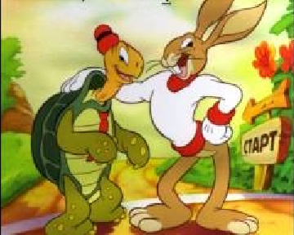
Past Simple

Slide 3
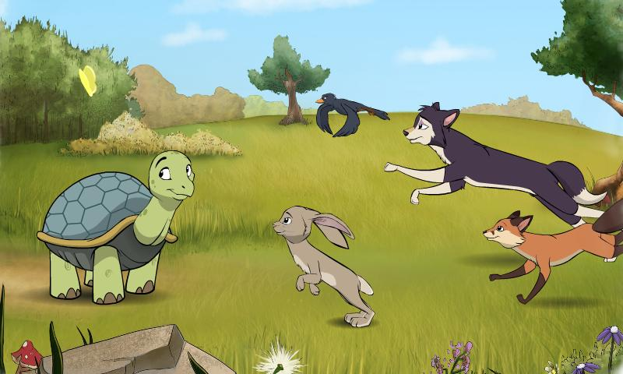
The day before yesterday
Yesterday Last week
…ago
Once Last year Last month

Slide 4
Regular verbs V → V- ed
[t]
Watched
Walked
Talked
Finished
Looked
[d]
Played
Learned
Tried
Cried
Smiled
studied
[id]
Skated
Wanted
Collected
Painted
needed

Slide 5
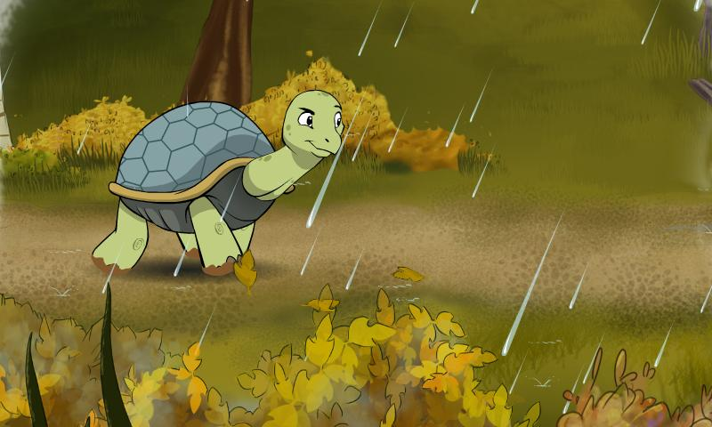
watched
learned
collected
cried
played
finished
painted
skated
walked
wanted
looked
talked
tried
needed
smiled
[t]
[d]
[id]

Slide 6
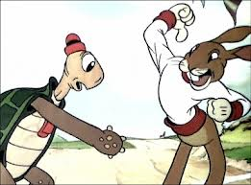
They skate in the yard every day.
They skated in the yard yesterday.
The weather is fine today.
The weather was fine yesterday.
We visit our grandmother every month.
We visited our grandmother yesterday.
I play with my friend every Sunday.
I played with my friend yesterday.
Children watch TV every day.
Children watched a good film yesterday.

Slide 7
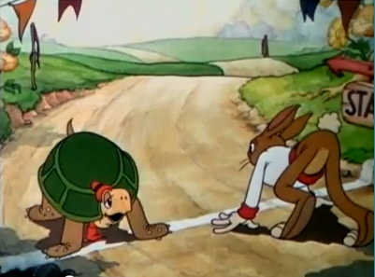
Negative sentences
I bought a carrot for my parrot.
The parrot didn’t like the carrot.
I bought a pear for my hare.
The hare didn’t like the pear.
I bought a house for my mouse.
The mouse didn’t like the house.
I bought a mat for my cat.
The cat didn’t like the mat.

Slide 8
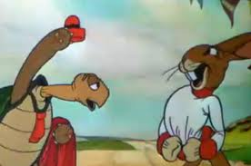
Образец: I watched TV at night.
You didn’t watch TV at night.
I washed my hands and face ten times.
I played chess with a champion.
I helped my friends to do their homework.
I cleaned my teeth three times.
You didn’t wash your hands and face ten times.
You didn’t play chess with a champion.
You didn’t help your friends to do their homework.
You didn’t clean your teeth three times.

Slide 9
General questions
Did you stay at home?
Did you fly to Rome?
Did your plane arrive at time?
Did you have a good time?
Did you swim in the sea?
Did you watch TV?
Did you spend a lot of money?
Were your journey very funny?
Were you happy?
Were you sad?
Were you angry?
Were you glad?

Slide 10
Образец: I watched TV at night.
Did you watch TV at night?
I washed my hands and face ten times.
Did you wash your hands and face ten times?
I played chess with a champion.
Did you play chess with a champion?
I helped my friends to do their homework.
Did you help your friends to do their homework?
I cleaned my teeth three times.
Did you clean your teeth three times?

Slide 11
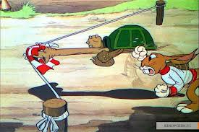
Good Bye!

Slide 12
Используемые материалы
http://kinohorror.com/upload/image/3/453.jpg
http://igrovoisait.ru/upload/video/thumbs/medium/b/9/4/b94d74c2ca405c61644067603f689b14.jpg
http://fs02.androidpit.info/ass/x83/5800983-1338292675068.jpg
http://fs02.androidpit.info/ass/x86/4978286-1327357131568.jpg
http://spletnik.ru/img/2009/12/dasha/20091204-zayciCherepa.jpg
http://maybebaby.com.ua/_pu/3/01019072.jpg
http://tivskazke.ru/img//2012/03/turtle-and-hear-race.jpg
http://images.16x9.tv/products/product_thumb_1982.jpg

