Slide 1
LEARNING BY NEW RULES

Slide 2
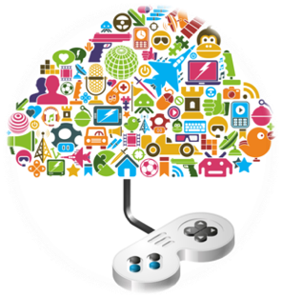
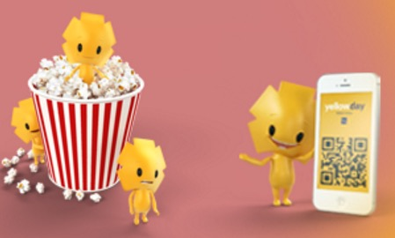
What is Gamification?
It’s the concept of applying game mechanics and game design techniques to engage and motivate people to achieve their goals

Slide 3
Motivation
Motivation directs behaviour toward particular goals.
Motivation leads to increased effort and energy.
Motivation increases initiation of and persistence in activities.
Motivation affects cognitive processes.
Motivation determines which consequences are reinforcing and punishing.
Motivation often enhances performance.

Slide 4
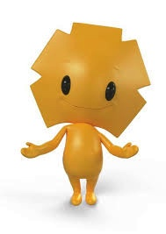
Gamification Origin
Businesses keep customers involved in a more active way
Companies acquire knowledge about customers preferences
Companies keep records of users’ data for better marketing purposes
Converge gaming and marketing achieved through competition and reward
Notes:
The advent of smart phones, tablets, etc. has made it easier for data on consumer preferences to be gathered because of monitoring preferences and choices.
Businesses keep customers involved in a more active way. ‘Pay with your card and collect points’, so people use Piraeus’ card in their transactions, not cash. If we are choosing flights, we select the one that gives us bonuses.
Companies acquire knowledge about customer preferences. When, where, what they buy. How they use their air miles.
Companies keep records of consumer preferences for better marketing from the data they gather.
Covert gaming and marketing achieved through completion and reward. This is what gamification means (examples given).

Slide 5
Gamification
& Learning
Report cards amay not be not enough motivation
Notes:
So, how can we make this applicable to our schools? How can we use it?
Most students describe the class as a boring place to be. Lecturing is not interesting to listen to. When I was a student I used to doodle while the teacher was lecturing that day’s lesson.
Report cards are certainly not enough motivation. Most students don’t care about reports, in fact most want to avoid them.

Slide 6
Gamification in Education
Motivates students to play by using game-like elements in non-game language tasks & activities
Reinforces self-directed learning

Slide 7
Game Mechanics

Slide 8
Points: Tangible, measurable evidence of my accomplishments

Slide 9
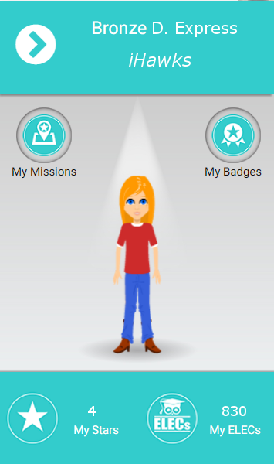
Students gain ELECs (English Language Experience Credits) while completing language tasks and when they get badges

Slide 10
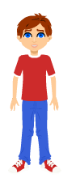
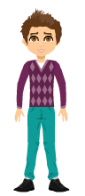
ELECs can be used to buy assets for their avatars

Slide 11
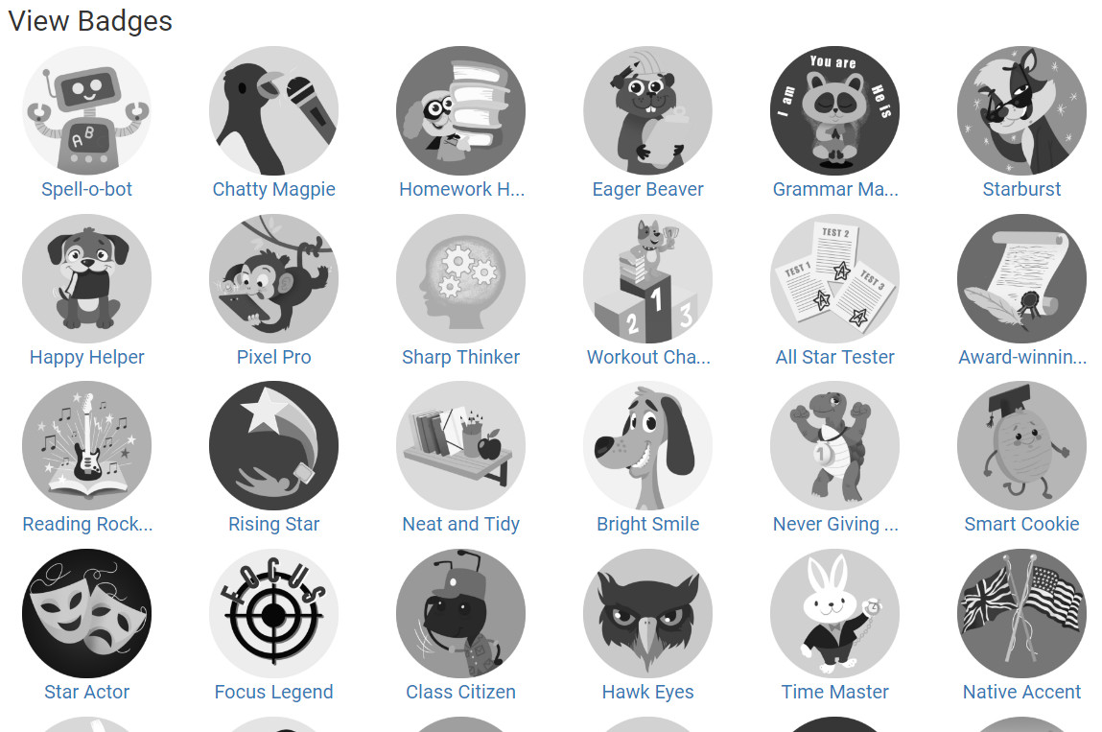
Badges: Evidence of accomplishment

Slide 12
Teachers can award students with Badges which give them extra ELECs (e.g. if they are well-prepared in class)
According to their importance, different badges have different ELECs value
Your spelling is great! Well done!
“Spell-o-bot” badge
50
The “Good effort” badge is 300 ELECs

Slide 13
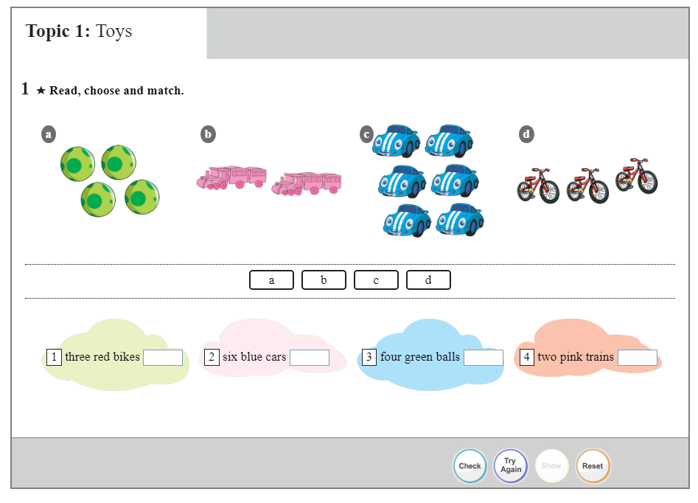
Fast Feedback: Immediate feedback or response to actions

Slide 14
Community: A context for achievement

Slide 16
Levelling Up: Status within my community
Students are assigned Missions
Once missions are completed, users earn stars.
The stars help them rise in 'Rank'
Diamond
Platinum
Gold
Silver
Bronze

Slide 17
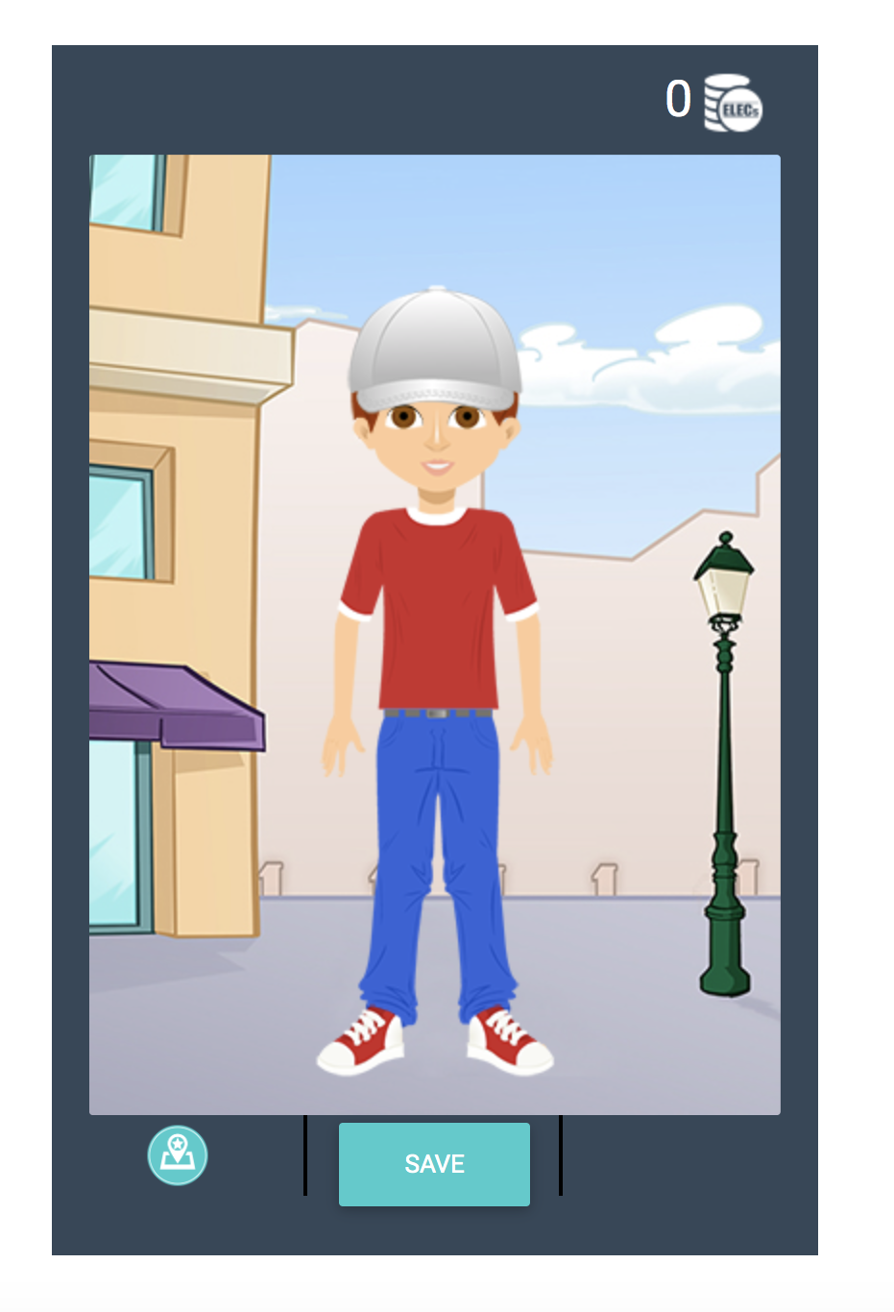
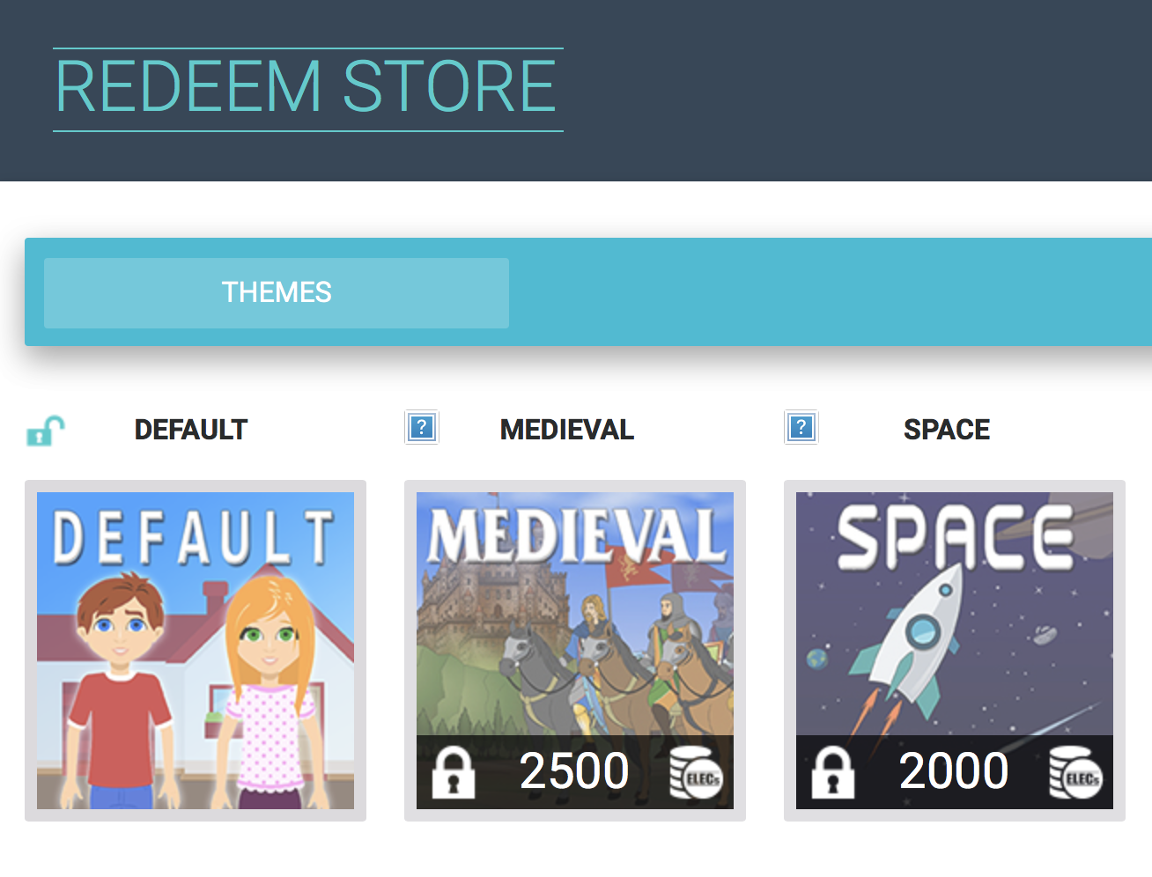
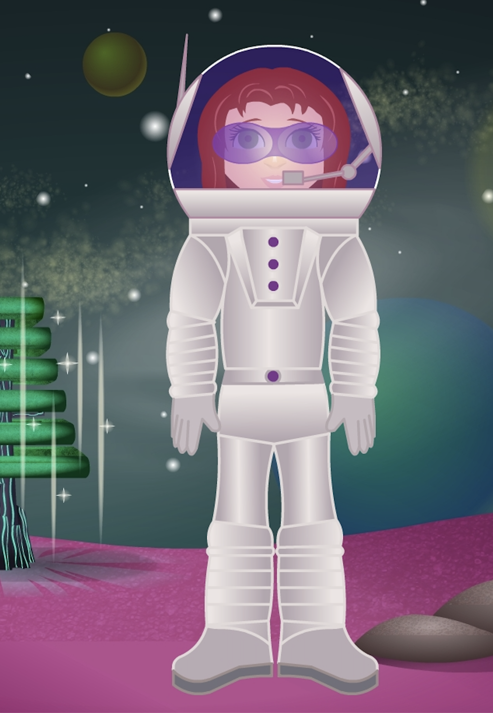
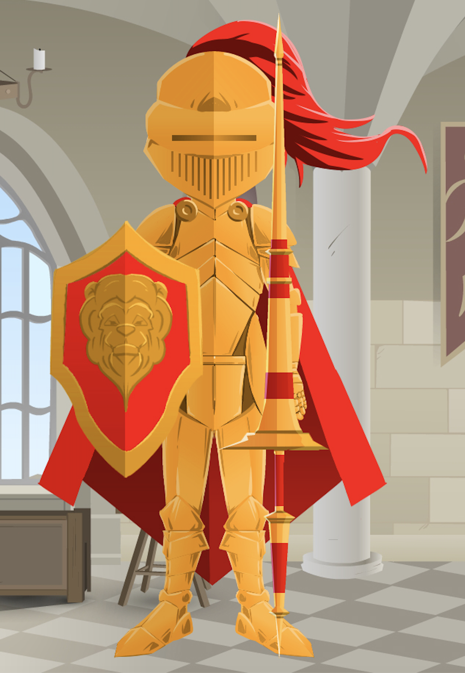
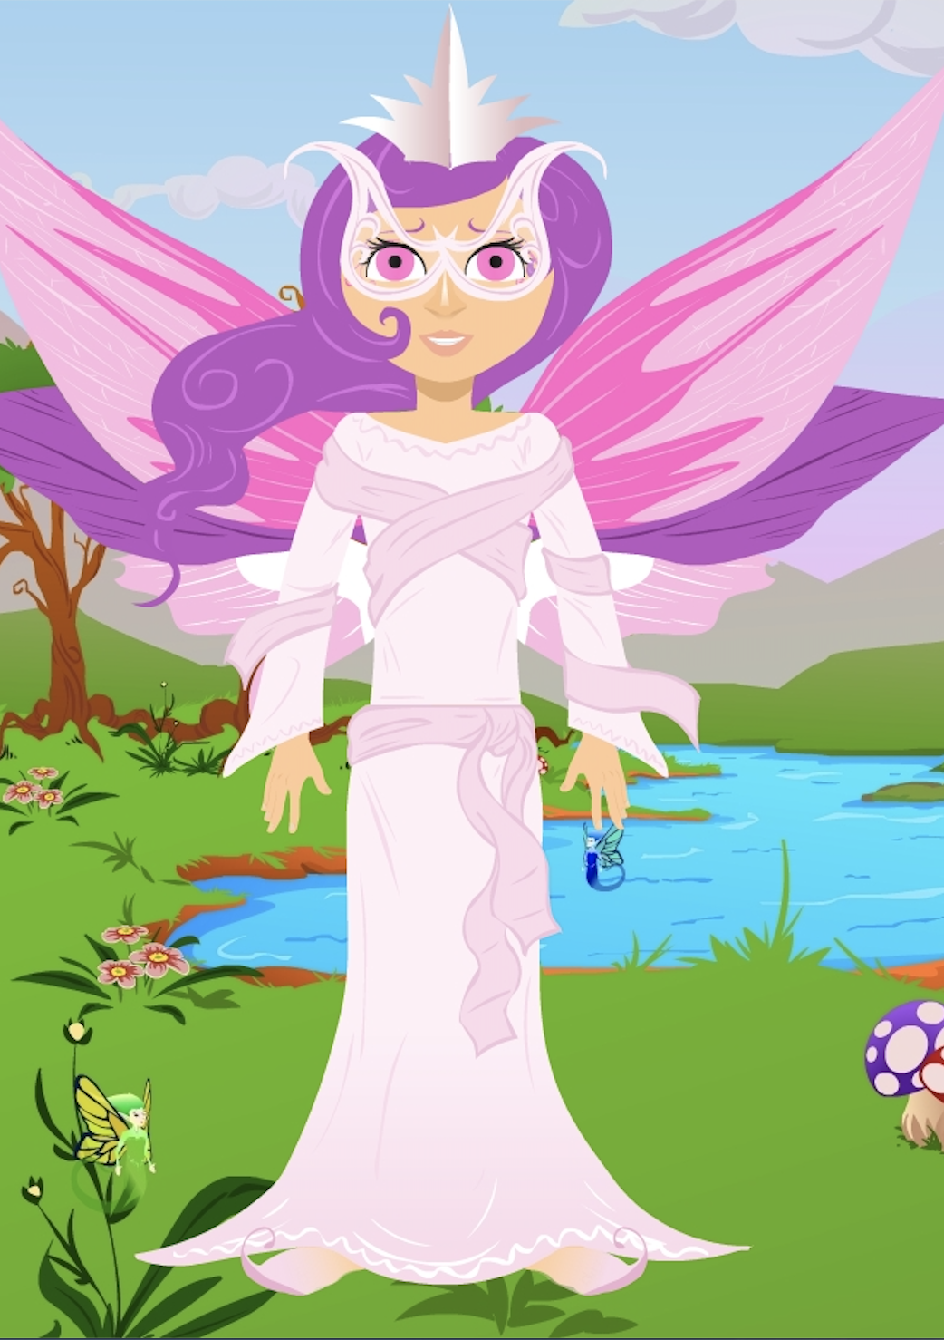
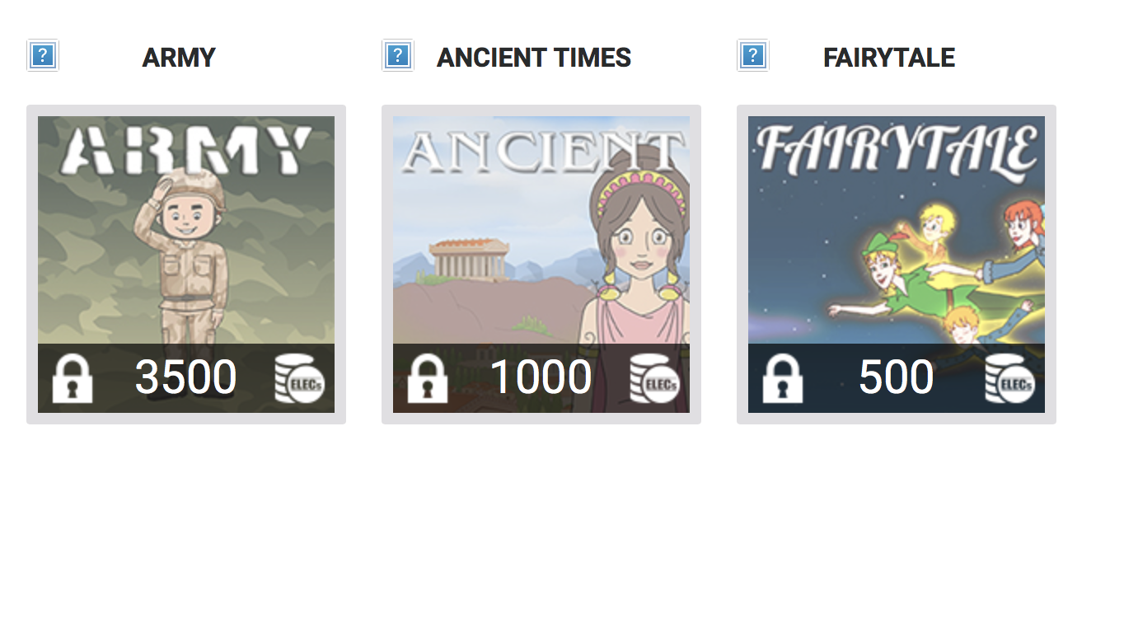
The higher the rank the more themes you can unlock.
Ranking
Diamond
Platinum
Gold
Silver
Bronze
You can also buy themes with ELECs

Slide 18
Transparency: Where everyone stands
Competition: How I’m doing compared to others
Collaboration: Accomplish a goal working with others

Slide 19
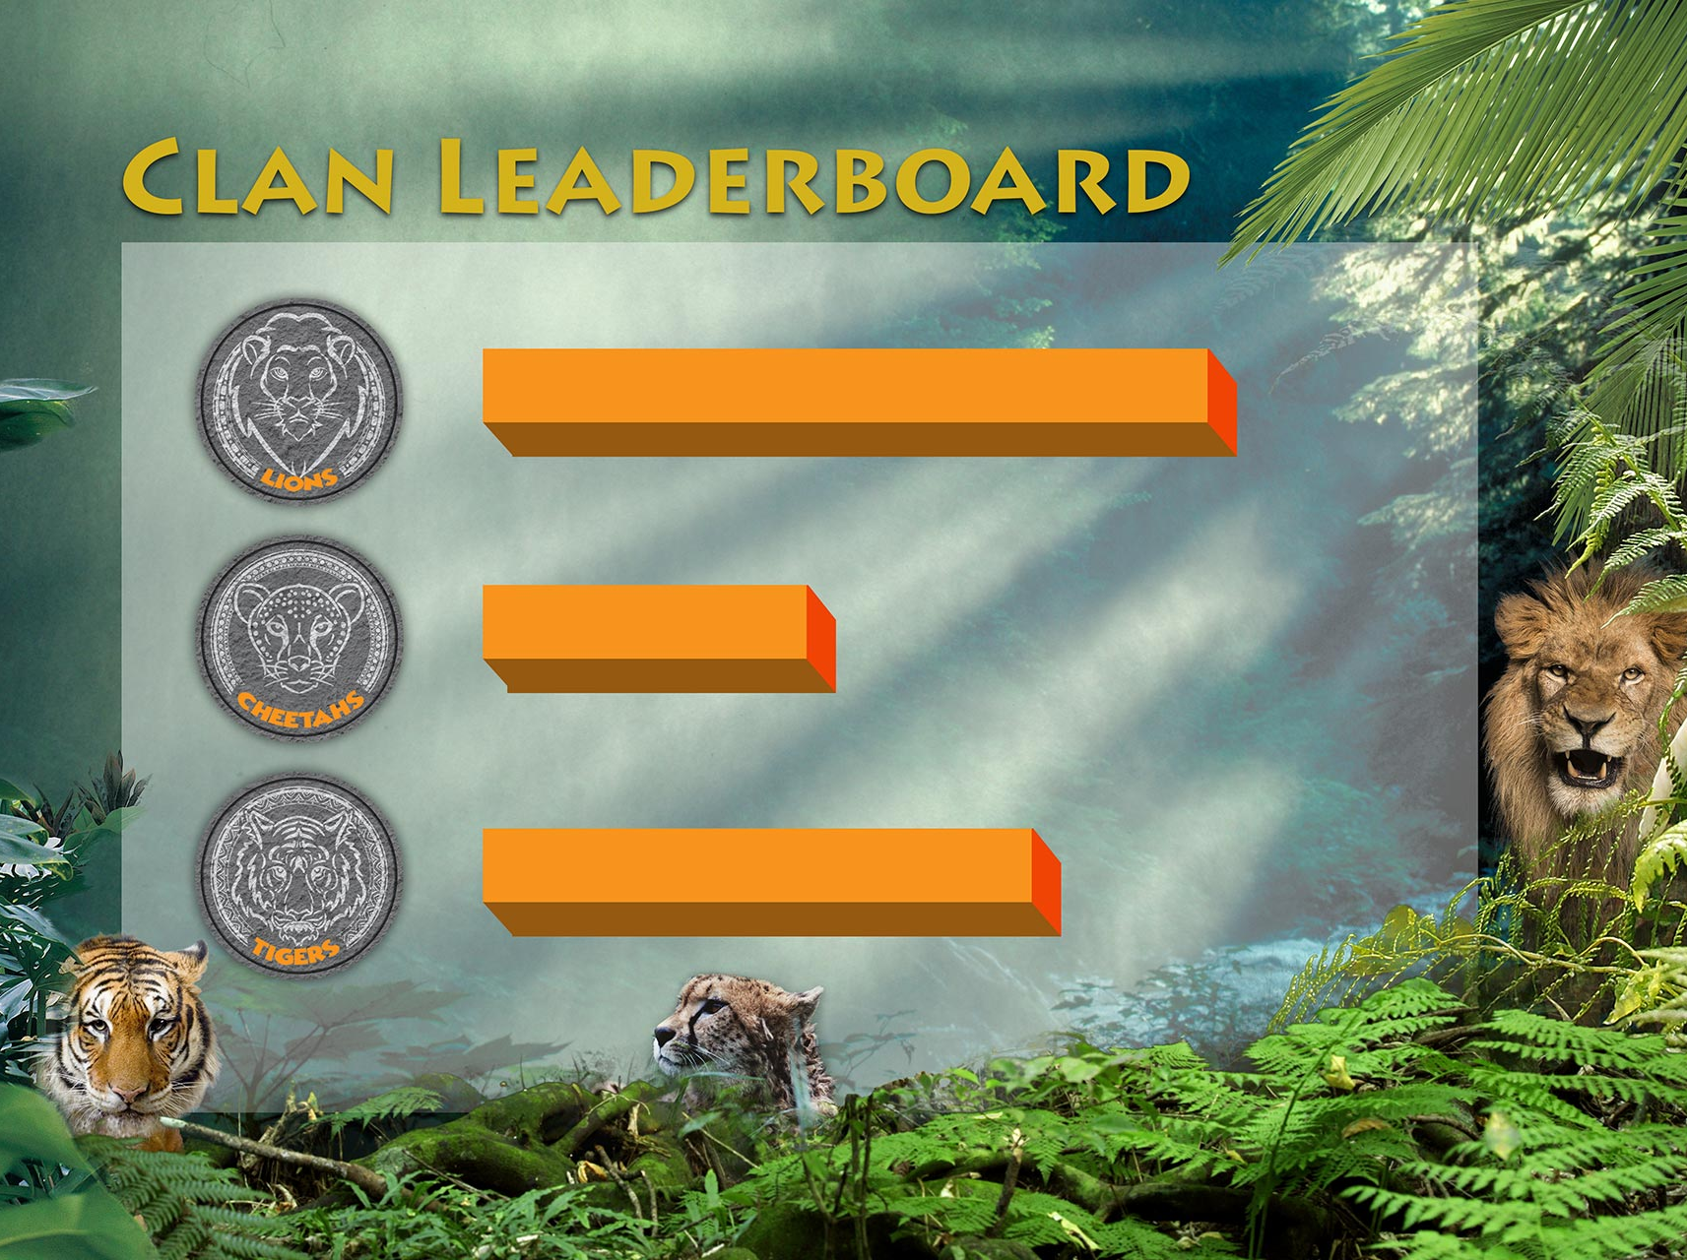

Slide 21
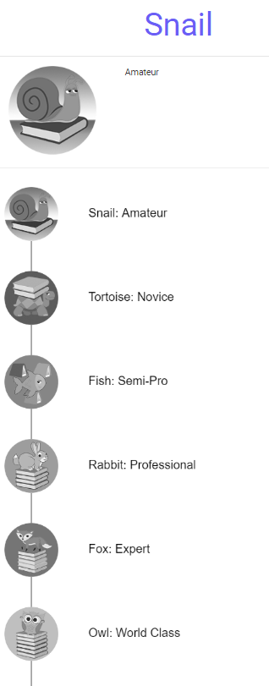
Goals: Short- and long-term goals to achieve
Library
bookworm
ELECs added by books
7 Badge reward system for every 5 books
Notes:
Missions or challenges give users a purpose for interaction, and educate users about what is valued and possible within the experience.

Slide 22
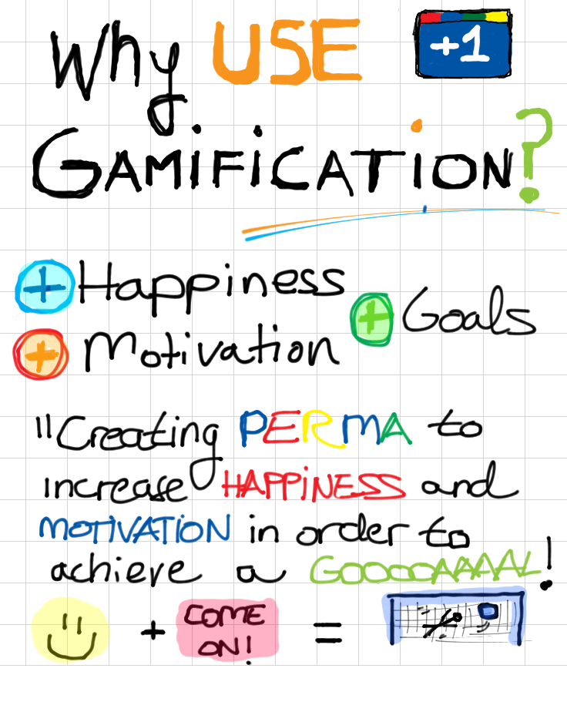
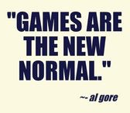
Notes:
Positive emotion
Engagement
Relationships
Meaning
Accomplishments
Martin Seligman

