Slide 1
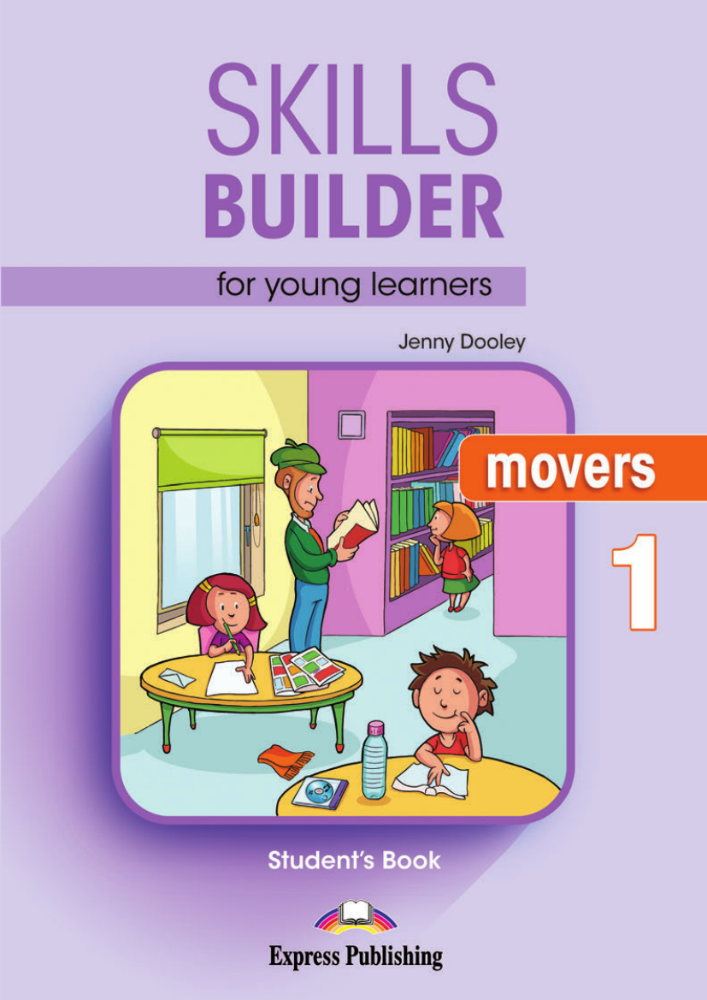
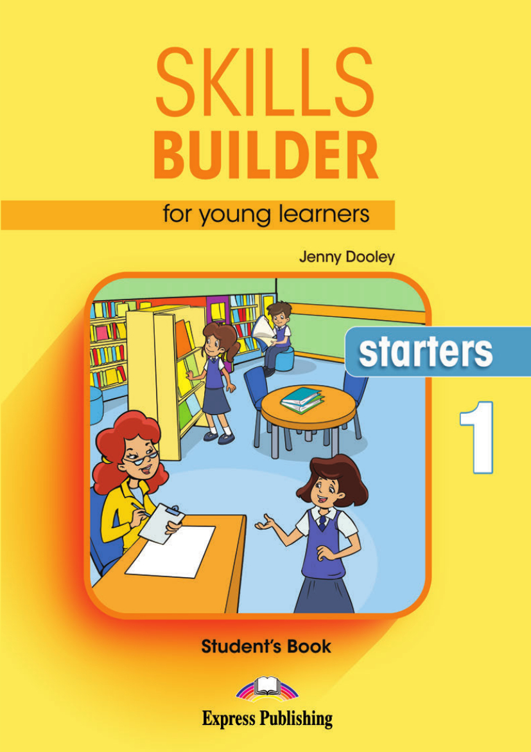
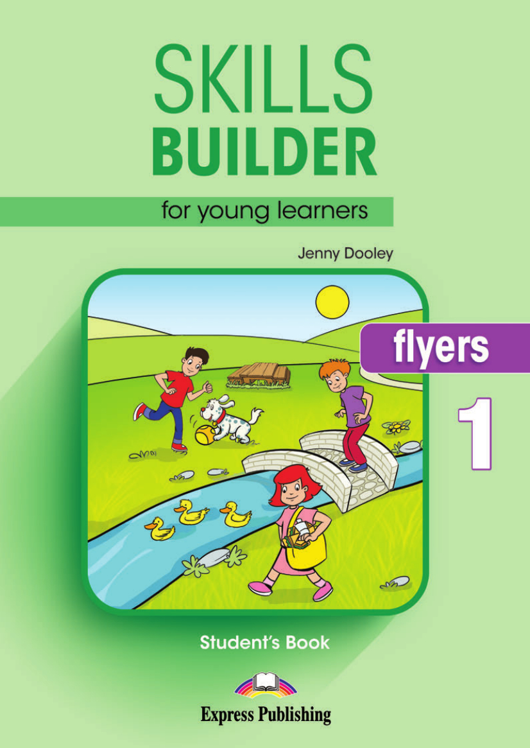

Slide 3
Structures
Verbs (Positive, negative, question, imperative and short answer forms, including contractions)
CAMBRIDGE ENGLISH: YOUNG LEARNERS HANDBOOK FOR TEACHERS

Slide 4
Verbs
Past continuous (for interrupted actions and background setting)
I was walking down the road when I saw her.
It was a very cold day and snow was falling.
CAMBRIDGE ENGLISH: YOUNG LEARNERS HANDBOOK FOR TEACHERS

Slide 5
Verbs
Present perfect
Have you ever been to the circus?
He’s just eaten his dinner.
CAMBRIDGE ENGLISH: YOUNG LEARNERS HANDBOOK FOR TEACHERS

Slide 6
Verbs
Be going to
It isn’t going to rain today.
CAMBRIDGE ENGLISH: YOUNG LEARNERS HANDBOOK FOR TEACHERS

Slide 7
Verbs
Will
Will you do your homework this evening?
I won’t buy her a CD because she doesn’t like music.
CAMBRIDGE ENGLISH: YOUNG LEARNERS HANDBOOK FOR TEACHERS

Slide 8
Verbs
Might
Vicky might come to the party.
CAMBRIDGE ENGLISH: YOUNG LEARNERS HANDBOOK FOR TEACHERS

Slide 9
Verbs
May
The bus may not come today because there is a lot of snow.
CAMBRIDGE ENGLISH: YOUNG LEARNERS HANDBOOK FOR TEACHERS

Slide 10
Verbs
Shall for suggestions
Shall we have a picnic in the park?
CAMBRIDGE ENGLISH: YOUNG LEARNERS HANDBOOK FOR TEACHERS

Slide 11
Verbs
Could
You could invite Robert to the football game.
CAMBRIDGE ENGLISH: YOUNG LEARNERS HANDBOOK FOR TEACHERS

Slide 12
Verbs
Should
Should we take a towel to the swimming pool?
CAMBRIDGE ENGLISH: YOUNG LEARNERS HANDBOOK FOR TEACHERS

Slide 13
Other structures
Tag questions
Adverbs
Conjunctions
If clauses (in zero conditionals)
Where clauses
Before/after clauses (not with future reference)
Be/look/sound/feel/taste/smell like
Make somebody/something + adj
What time …?
What else/next?
See you soon/later/tomorrow etc.
Be made of
CAMBRIDGE ENGLISH: YOUNG LEARNERS HANDBOOK FOR TEACHERS

Slide 14
Topics
Animals
The body and face
Clothes
Colours
Family and friends
Food and drink
Health
Home
Materials
Names
Numbers
Places & directions
School
Sports and leisure
Time
Toys
Transport
Weather
Work
World around us
CAMBRIDGE ENGLISH: YOUNG LEARNERS HANDBOOK FOR TEACHERS

Slide 15
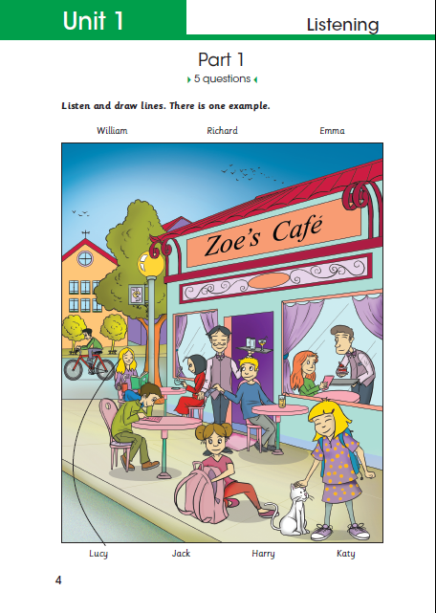
Notes:
Main Skill Focus
Listening for names and descriptions
Input
Picture, names and dialogue
Expected Response
Draw lines to match names to
people in a picture
No of Questions
5

Slide 16
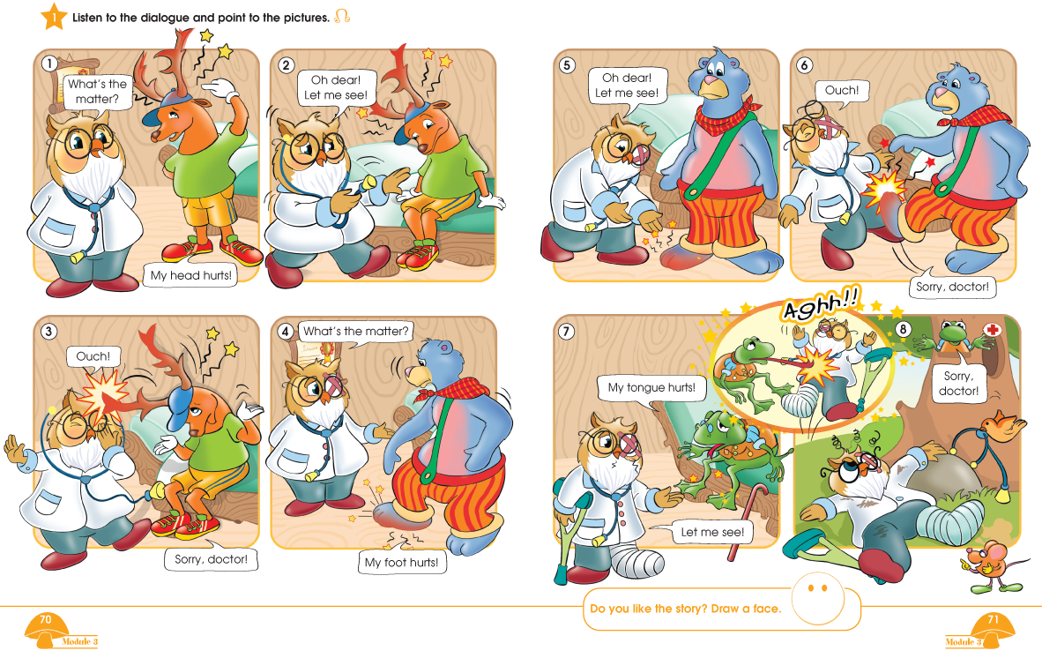

Slide 17
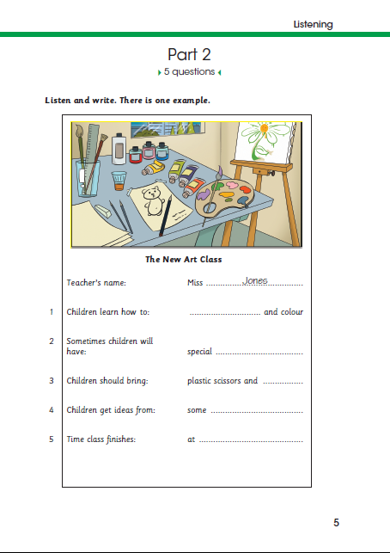
Notes:
Main Skill Focus
Listening for names, spellings and other information
Input
Form or page of a notepad with missing words and dialogue
Expected Response
Write words or numbers in gaps
No of Questions
5

Slide 19
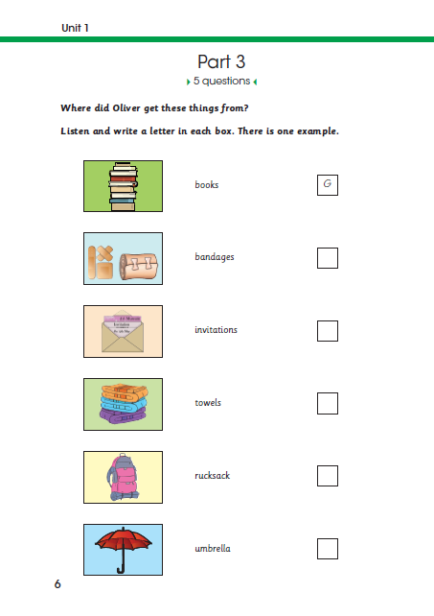
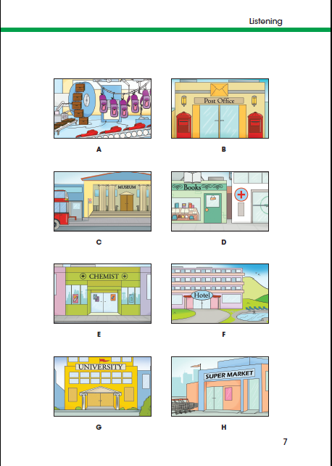

Slide 20
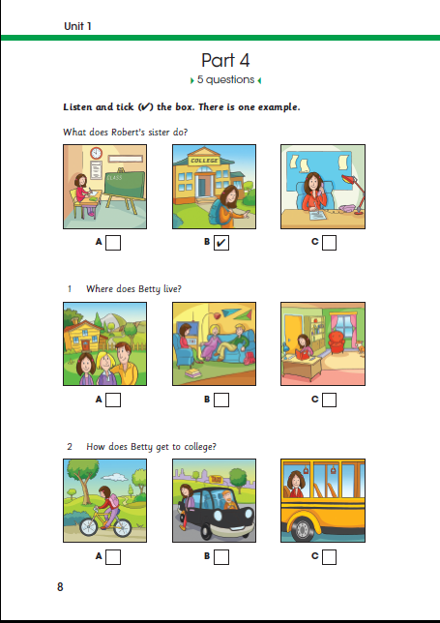
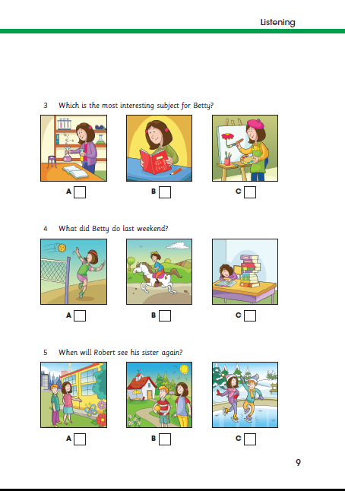

Slide 21
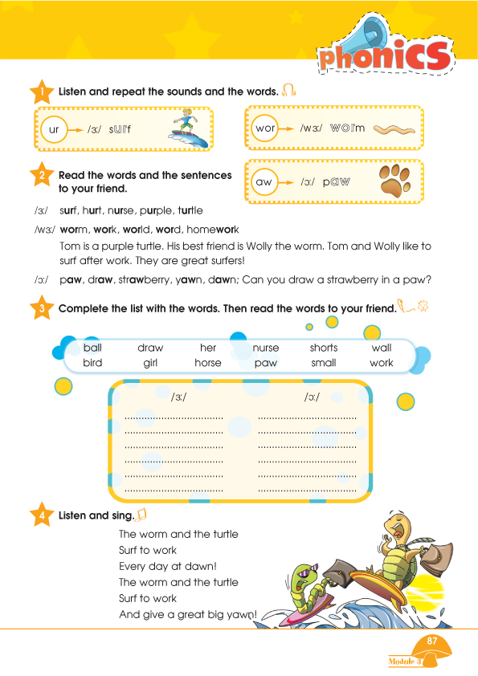
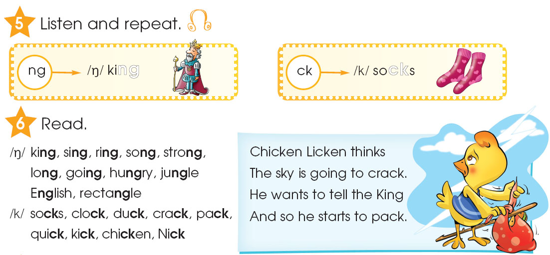

Slide 22
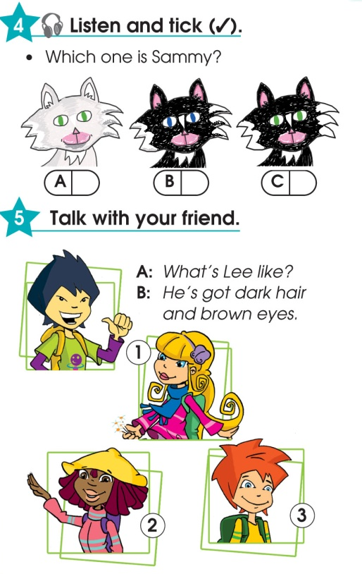

Slide 23
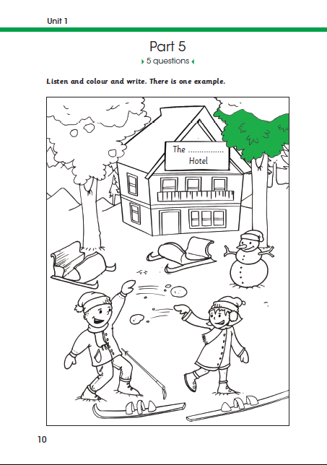

Slide 24
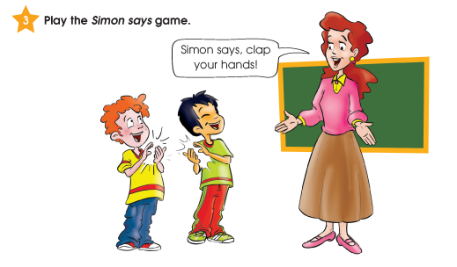
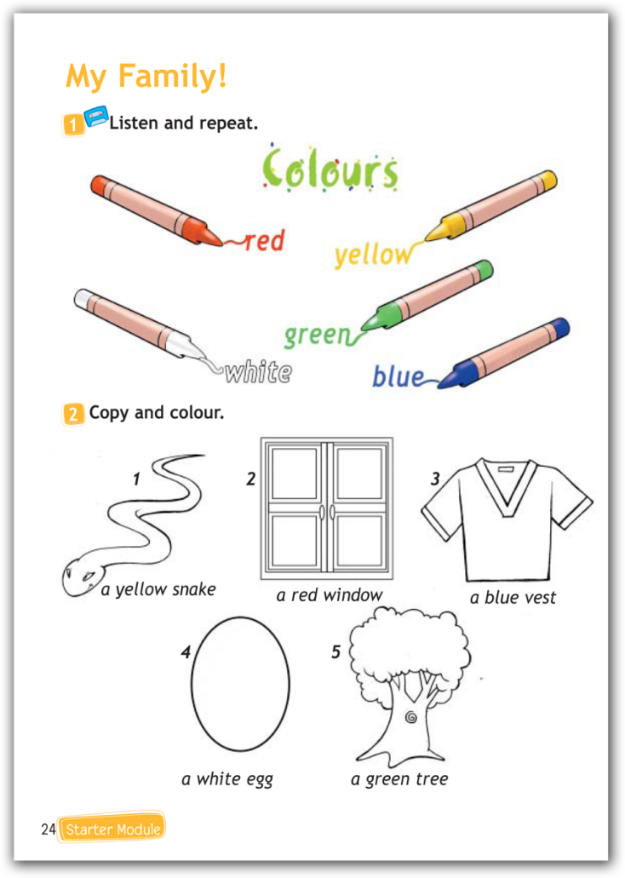
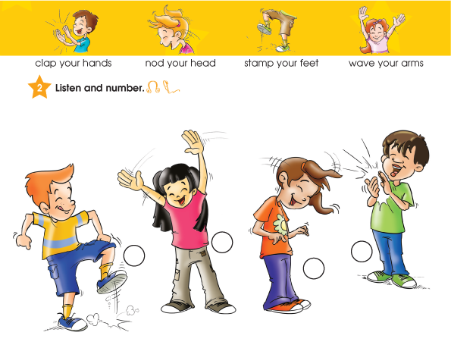

Slide 25
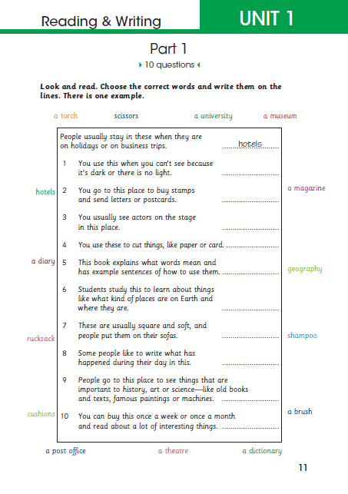

Slide 26
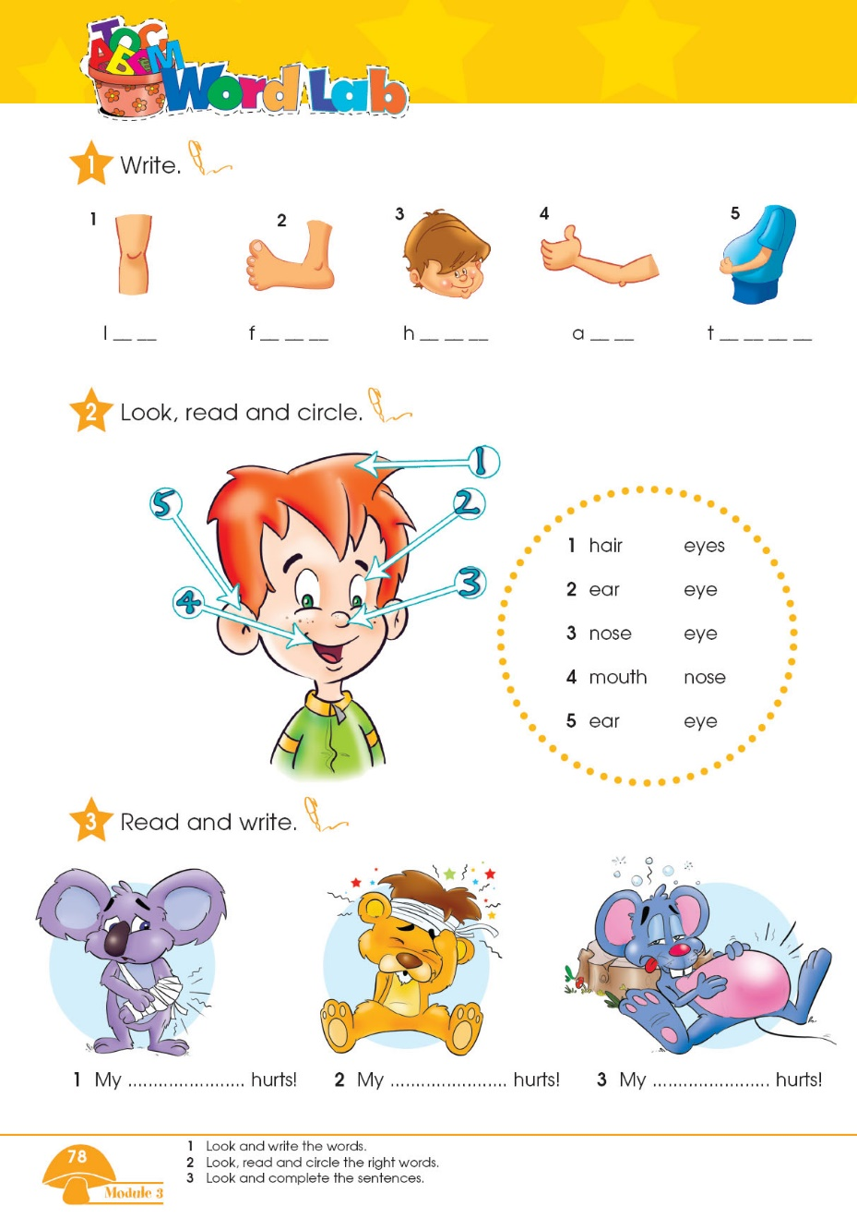

Slide 27
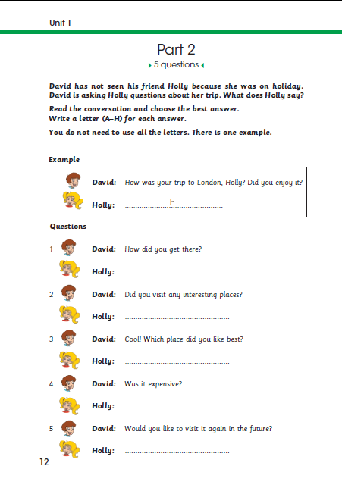
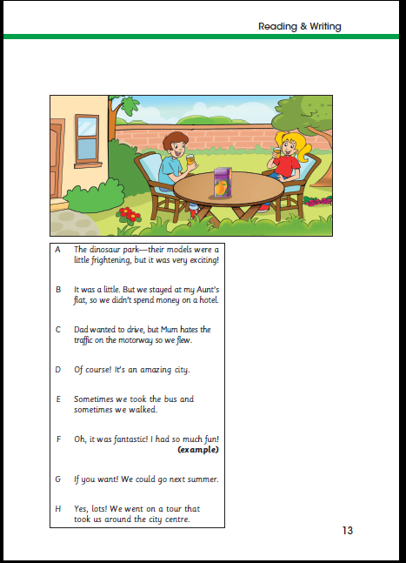

Slide 28
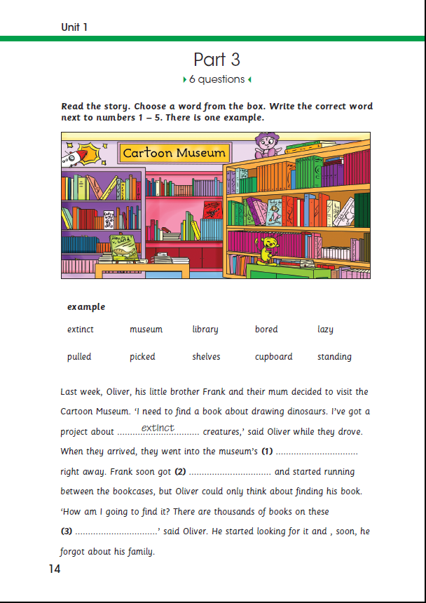
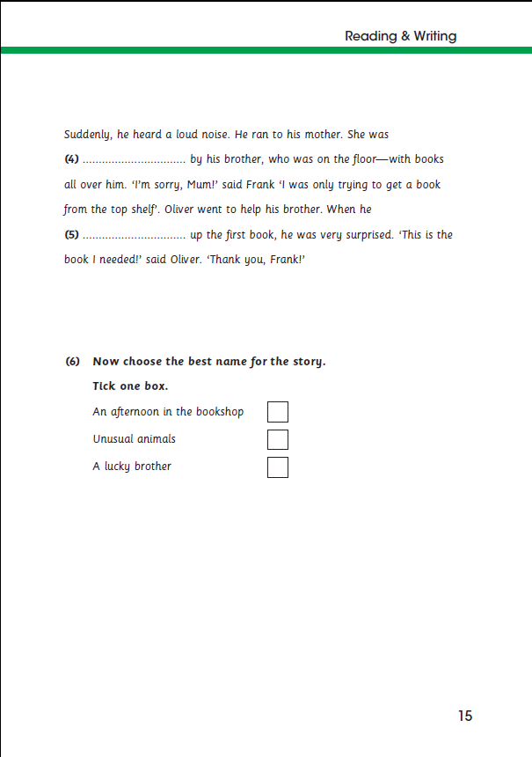

Slide 29
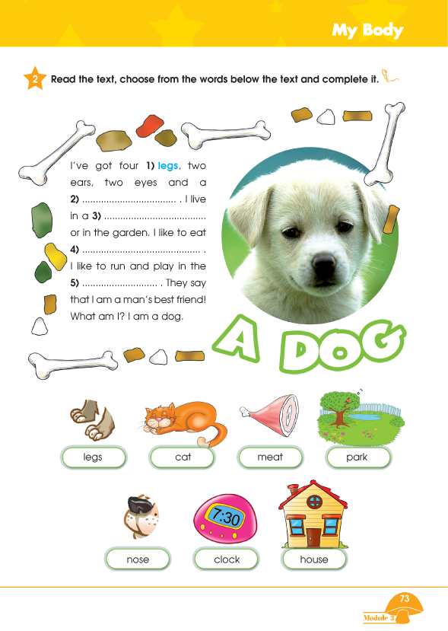

Slide 30
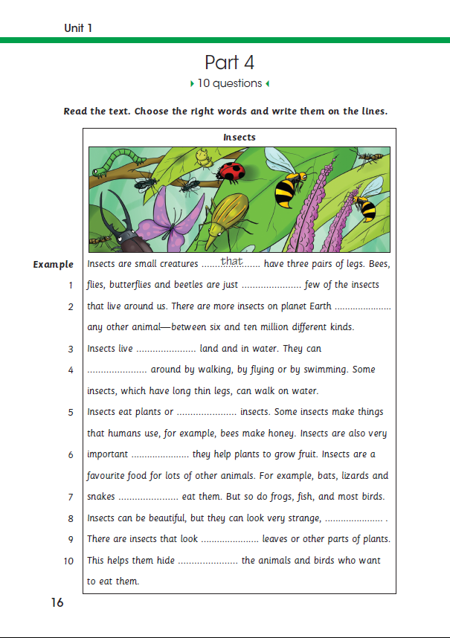
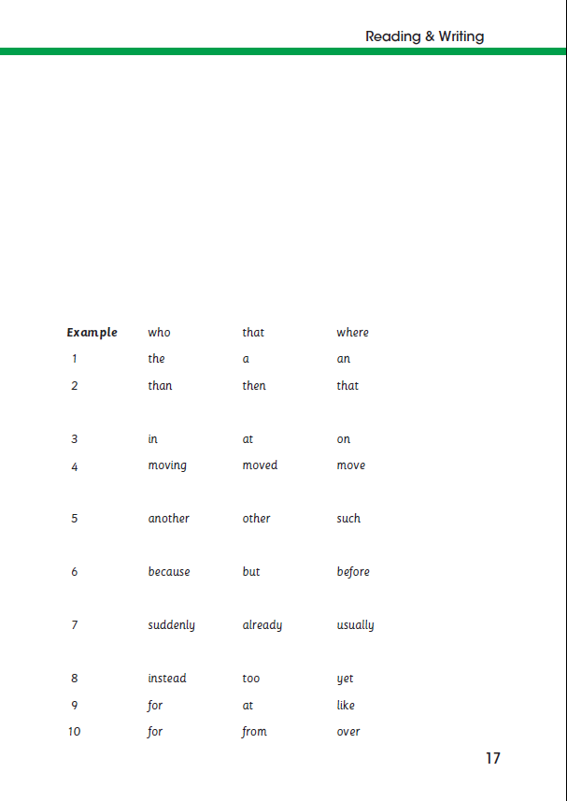

Slide 31
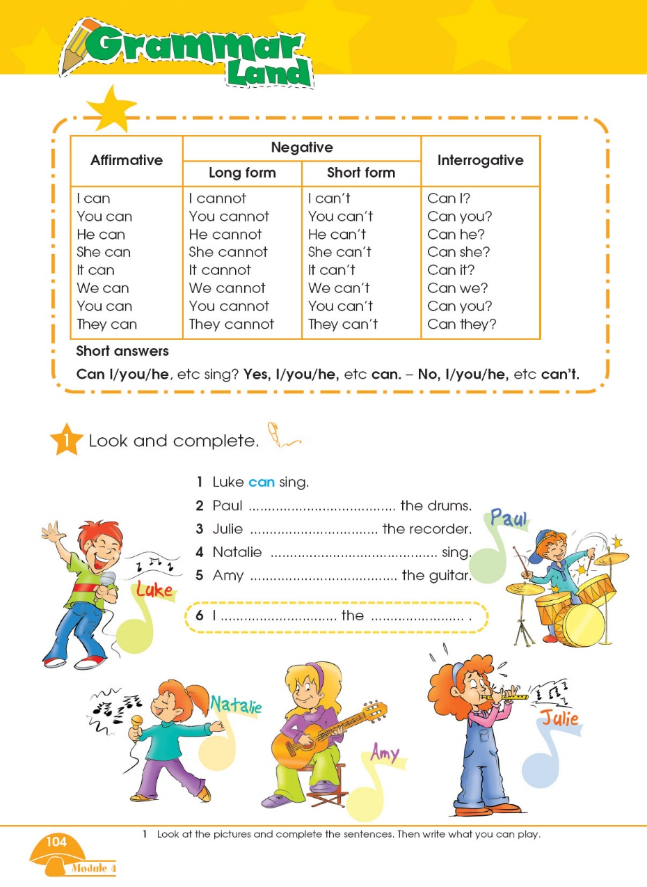
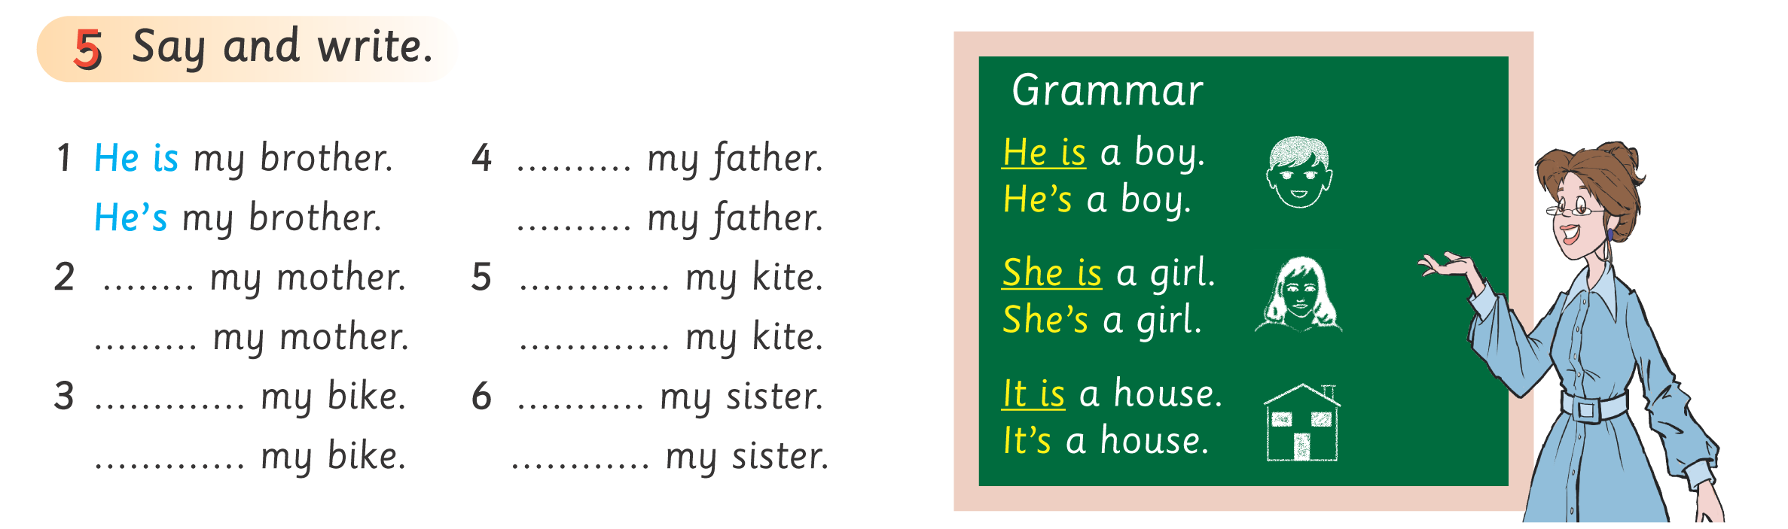

Slide 32
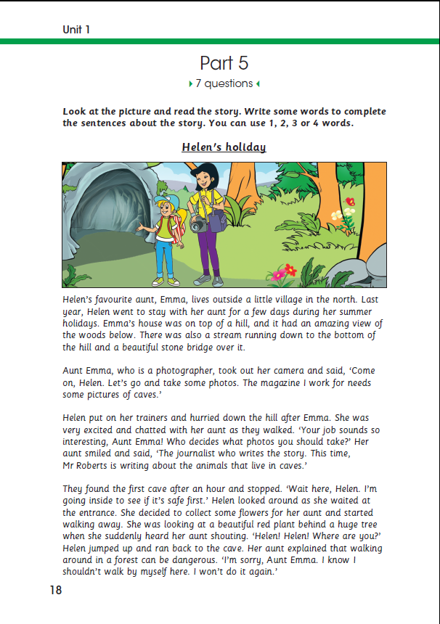
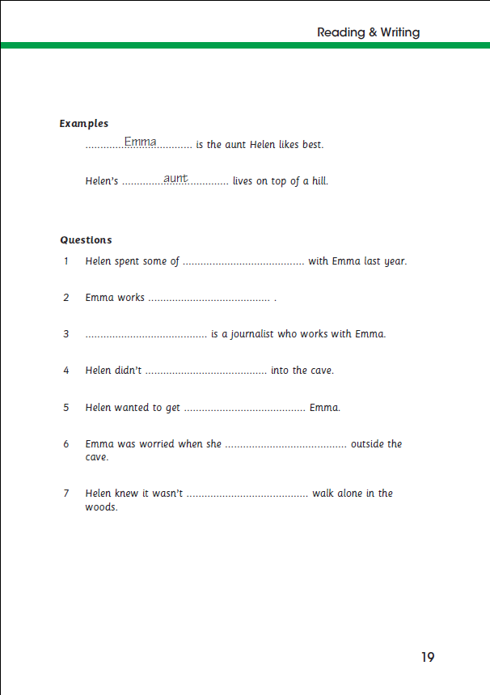

Slide 33
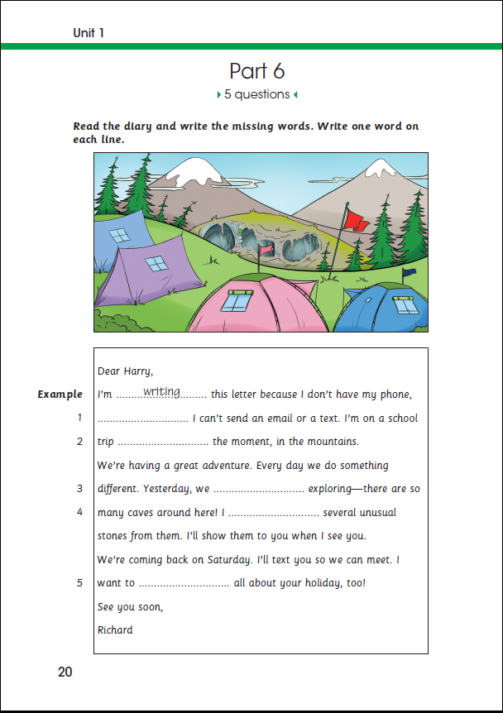

Slide 34
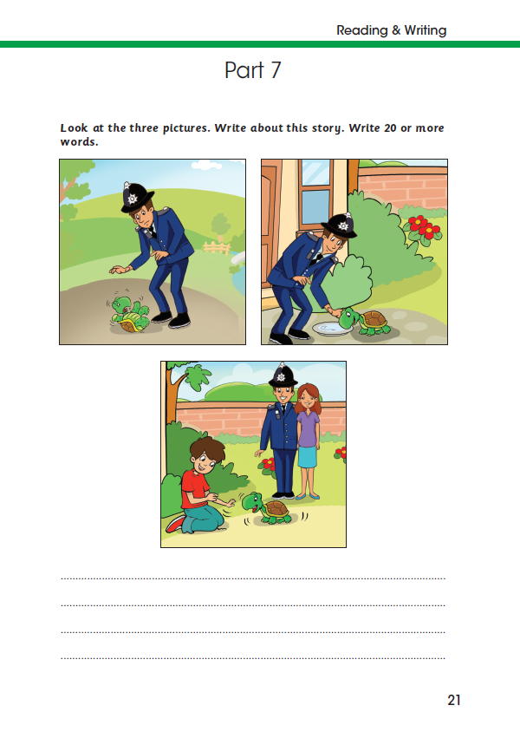

Slide 35
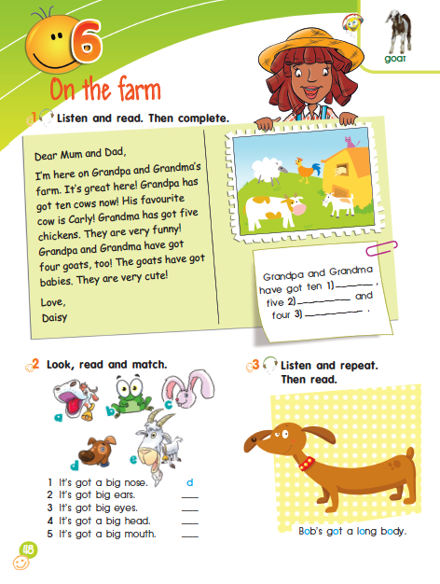
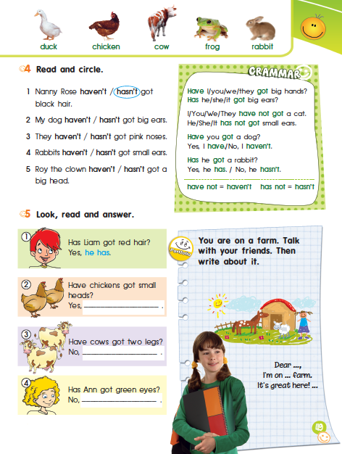

Slide 36
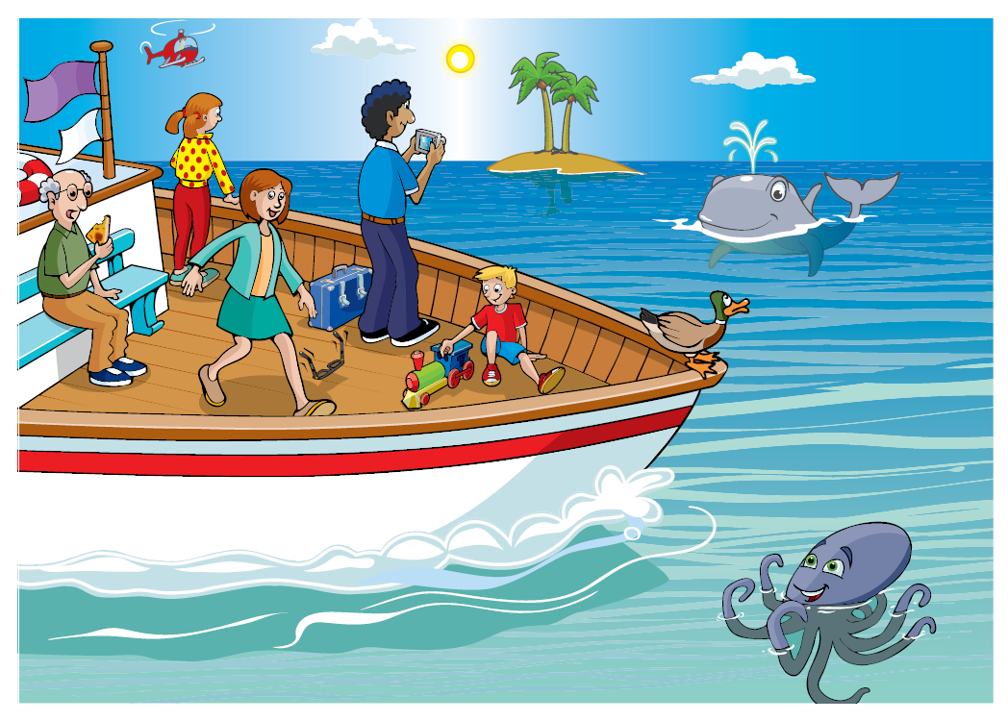
CAMBRIDGE ENGLISH: YOUNG LEARNERS HANDBOOK FOR TEACHERS

Slide 37
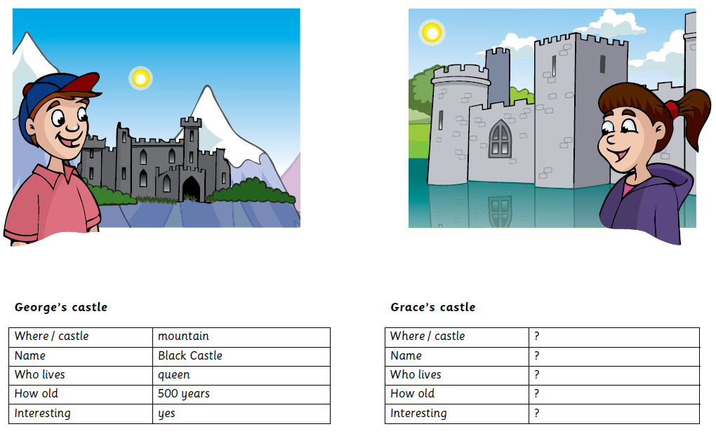
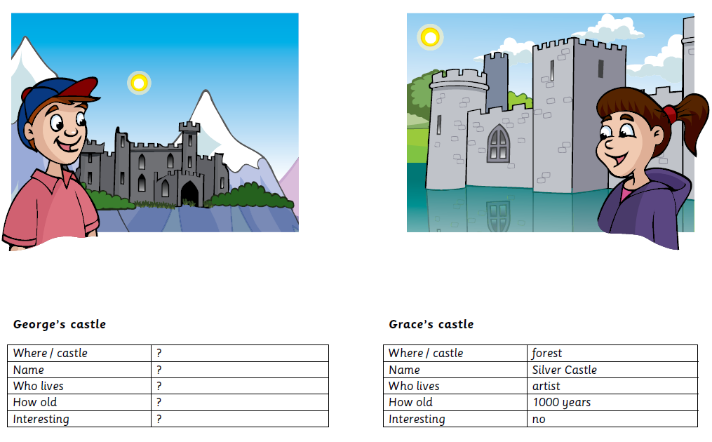
CAMBRIDGE ENGLISH: YOUNG LEARNERS HANDBOOK FOR TEACHERS

Slide 38
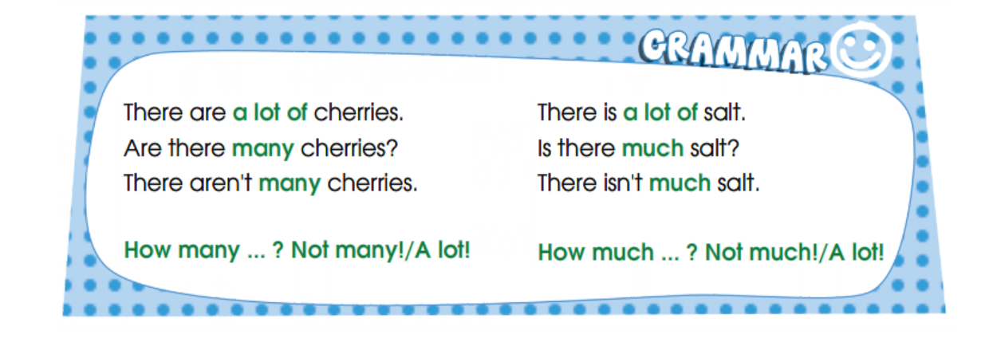

Slide 39
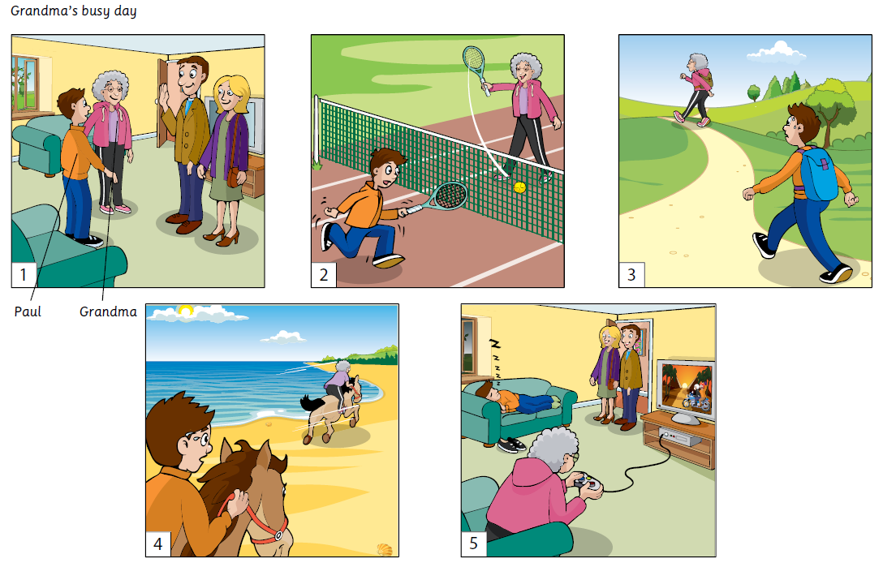
CAMBRIDGE ENGLISH: YOUNG LEARNERS HANDBOOK FOR TEACHERS

Slide 40
