Slide 1
Animals

Slide 2
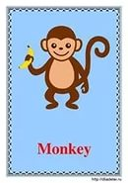
Monkey

Slide 3
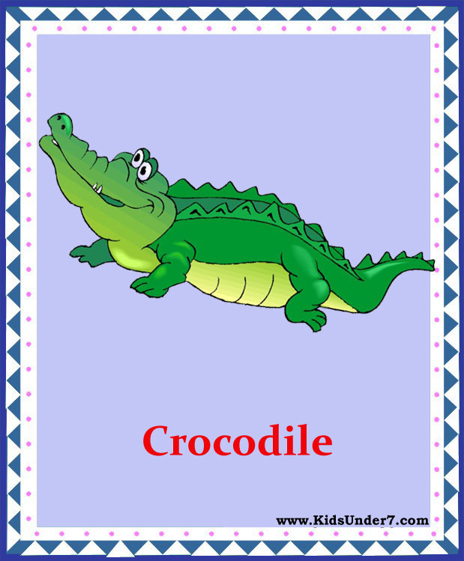
Crocodile

Slide 4
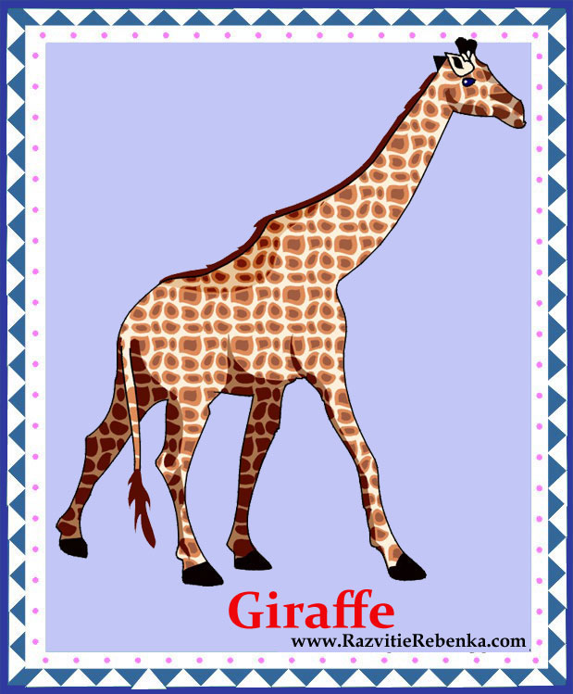
Giraffe

Slide 5
Lizard

Slide 6
Dolphin

Slide 7
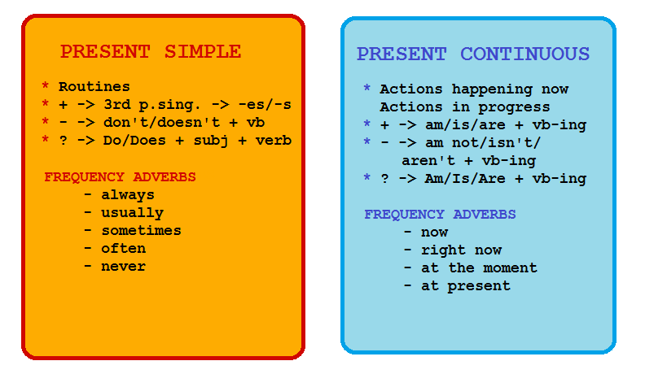

Slide 8
Look! The children are having lunch now. They usually have lunch at 12 o’clock

Slide 9
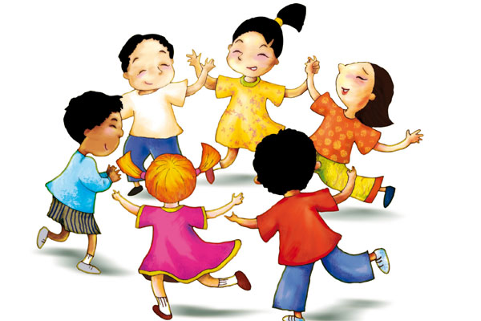
Let’s play

Slide 10
Рефлексия
Can you talk about things happening now?
Can you talk about things that happen regularly?

Slide 11
Goodbye!

