Slide 1
Have a lot of fun
Learn
Enjoy
Read

Slide 2
A is for Apples and Apple-trees You can see apples on apple-trees
Aa
[eɪ]

Slide 3
B is for Books and for Bookcase. I have many books in my bookcase
Bb
[bɪ:]

Slide 4
C is for Cat. My cat is grey, And with me it likes to play
Cc
[sɪ:]

Slide 5
D is for Dog
Dd
[dɪ:]
And for Doggy
I have a dog,
not a doggy

Slide 6
E is for Eight
and for
Ee
[ɪ:]
How much is
and
?

Slide 7
F is for Flowers: red and blue, White and yellow and rosy, too.
Ff
[ef]

Slide 8
G is for Girl, and also for Garden I see a girl going to the garden.
Gg
[dʒɪ:]

Slide 9
H is for Hand. I have two hands.
Hh
[eitʃ]
This is the way I clap my hands

Slide 10
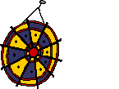
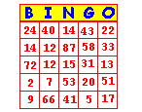
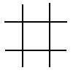
I is for I. I’m a boy, and I’m ten. I like to play with my brother Ben.
Ii [ai]

Slide 11
J is for Jam. This is apple jam. Jimmy likes it, and so does Sam.
Jj
[dʒei]

Slide 12
K is for Kite. Kate has a kite. It is little, and it is not white.
Kk
[kei]

Slide 13
L is for Letter. This letter is for me. It is from my sister, as you can see.
Ll
[el]

Slide 14
M is for May and May Day, For March and for Mother’s Day.
Mm
[em]
“Happy Mother’s Day!”

Slide 15
N is for Nine, Ninety and Ninety-nine. Children, how much is ninety and nine?
Nn
[en]
+

Slide 16
O is for One. One and two are three. Three little cats in a tree.
Oo
[əu]
+
=

Slide 17
P is for Pencils. With them I can draw: A red pen, a green tree or a blue door.
Pp
[pi:]

Slide 18
Q is for Questions: How are you? How old are you? And How do you do?
Qq
[kju:]

Slide 19
R is for Red. Many things are red. What can be red? Do you know, Fred?
Rr
[a:ʳ]
a red apple
a red flag
red flowers
a red letter

Slide 20
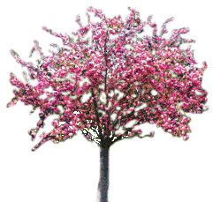
S is for Street. This is my street. There are a lot of trees in my street
Ss
[es]

Slide 21
T is for Tick and for Tock. “Tick-tock”, says the clock
Tt
[ti:]

Slide 22
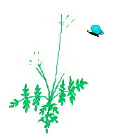
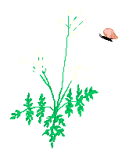
U is for Under, but not for At. “I’m under the tree”, says Pat.
Uu
[ ju:]

Slide 23
V is in Five
And also in seven
Vv
[vi:]
It is in Twelve
and in Eleven

Slide 24
W is for
Where?
When?
Why?
and
What?
Ww
['dʌbl ju:]
Who is in the garden?
and
Who is not?

Slide 25
X is in Six. Let’s count up to six!
one
two
three
Xx
[eks]
four
five
six

Slide 26
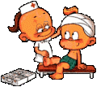
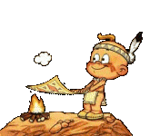
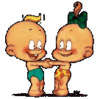
Y is for a Yard where children play. They play in the yard every day.
Yy
[wai]

Slide 27
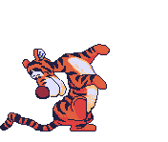
Z is for the Zoo. Let’s go to the Zoo. I like to go to the Zoo. And you?
Zz
[zed]

Slide 28
I know all leters well,
I can read them all and spell.
Oh! Well, you see,
Now I can say the ABC!

